Slide 1
Pupil Premium - Importing and Maintaining
Version 1.1

Slide 2
Downloading the DfE CSV file

Slide 3
Downloading the DfE CSV File
We expect the DfE to make two versions of the CSV file available to schools
We expect the first version to be made available by the DfE in July and the second in November
The first download contains all your premium pupils, but for looked after information makes use of a list of looked after pupils based on an LA collection that took place some while ago, while the second download uses an up to date list of looked after pupils.
Most schools won’t import the Looked After Pupil Premium information as it isn’t paid to the school and is likely to be incomplete. So from an import point of view the second import may not be of interest
However, from a financial point of view the second download is likely to be of interest as it reflects the total amount of Pupil Premium funding provided to the school.

Slide 4
Downloading the DfE CSV File
It is important to download the DfE CSV file to a secure folder as it includes UPN and other information that is usually regarded as sensitive, e.g. adopted from care.

Slide 5
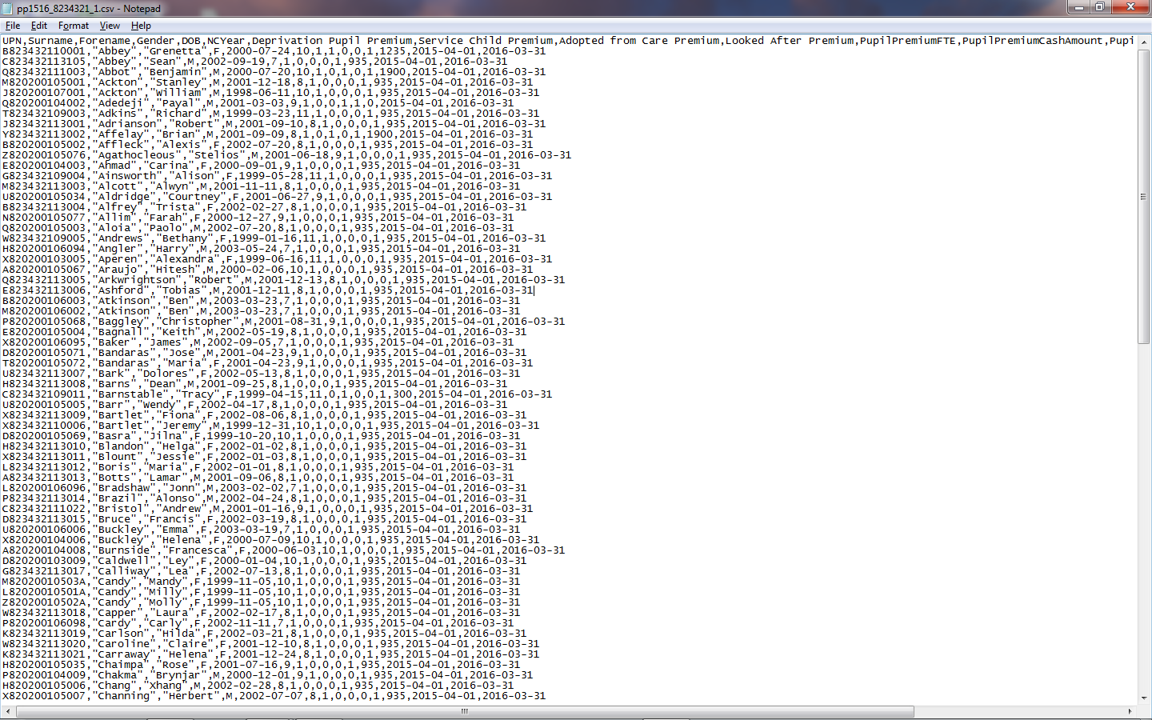
This is what we expect the DfE CSV file to look like when opened in Notepad

Slide 6
Importing Information from the DfE CSV file

Slide 7
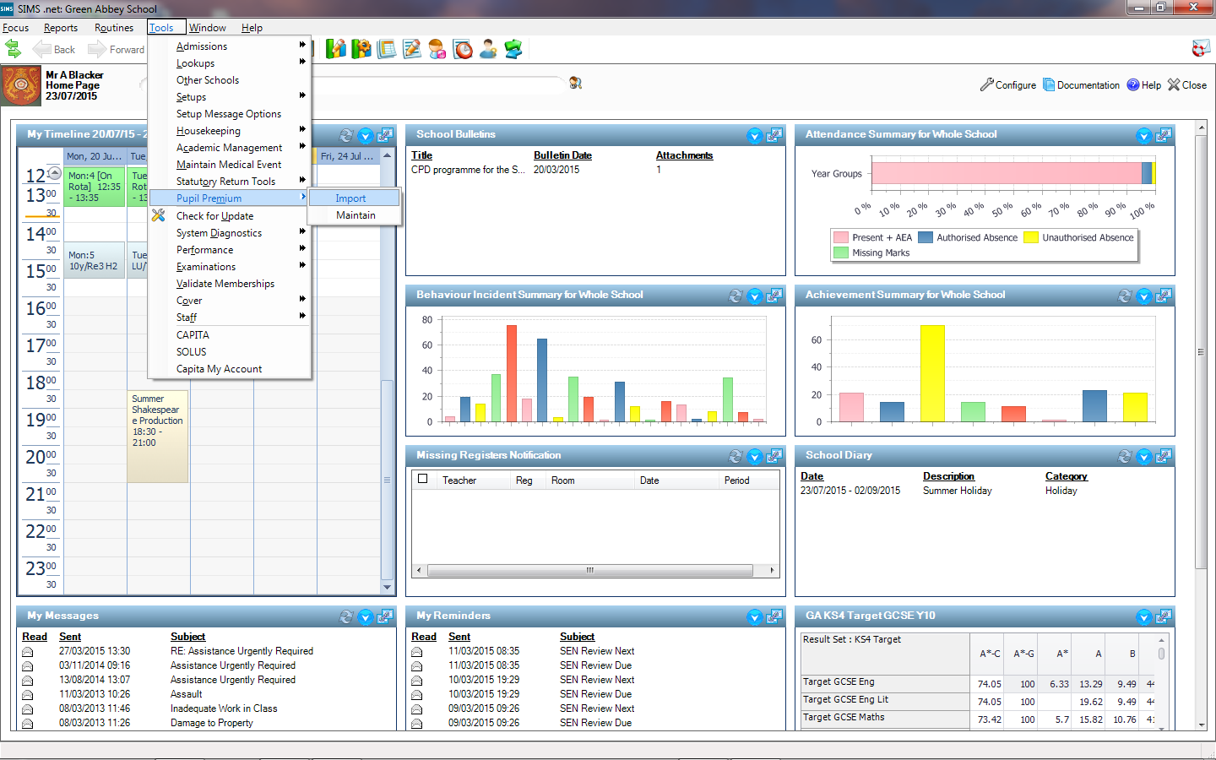

Slide 8
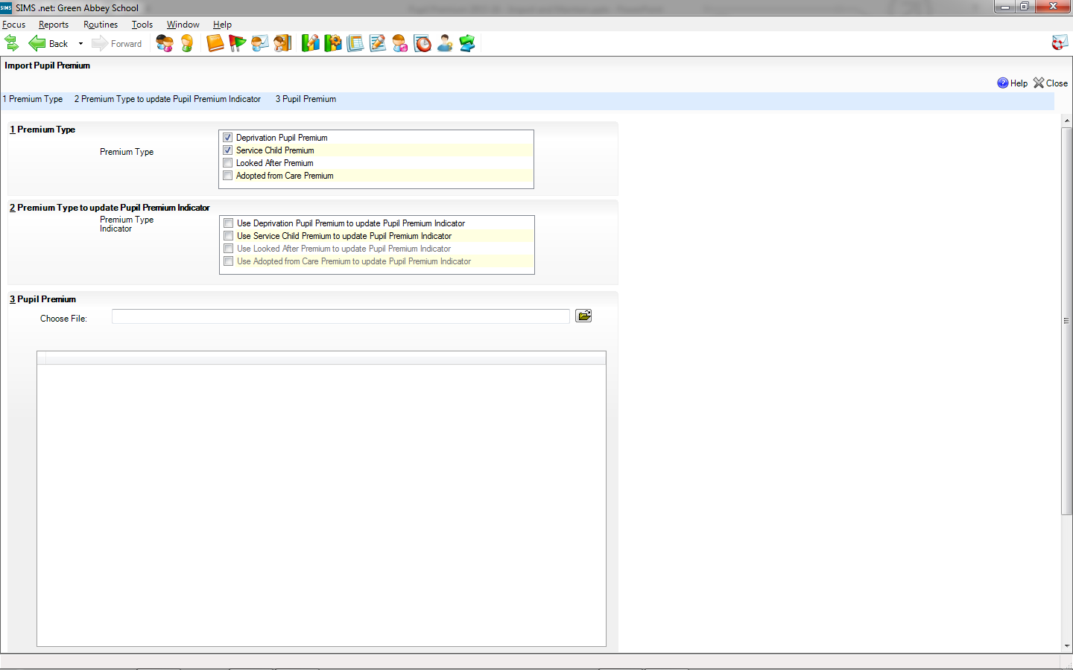
We can tick to indicate which types of Pupil Premium we want to import from the DfE file. The Deprivation Pupil Premium and Service Child Premium are ticked by default in line with what was available for import last year
We suggest that Looked After Premium is not worth importing as it is likely to provide an incomplete and out of date picture, i.e. it is only included where it is stopping the school from receiving other premiums and it is not based on School Census information

Slide 9
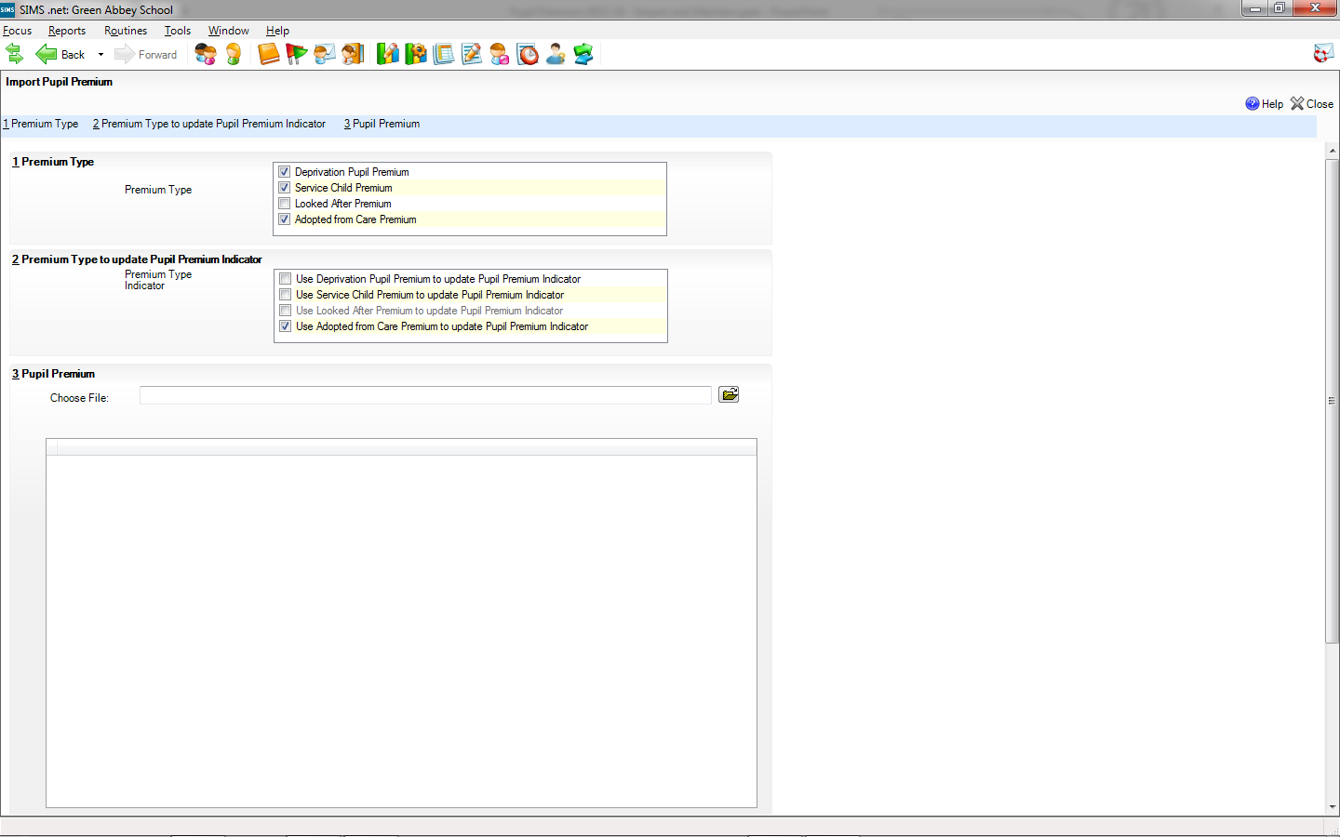
Updating of the Pupil Premium Indicator always excludes the types that the user has decided not to import, but we have made it possible to import the premium type without updating the Indicator. This can be helpful where the school wants to import the information but doesn’t want the information to be readily available via the Indicator

Slide 11
Once we have indicated what we want to import and update we must choose the CSV file to import

Slide 12
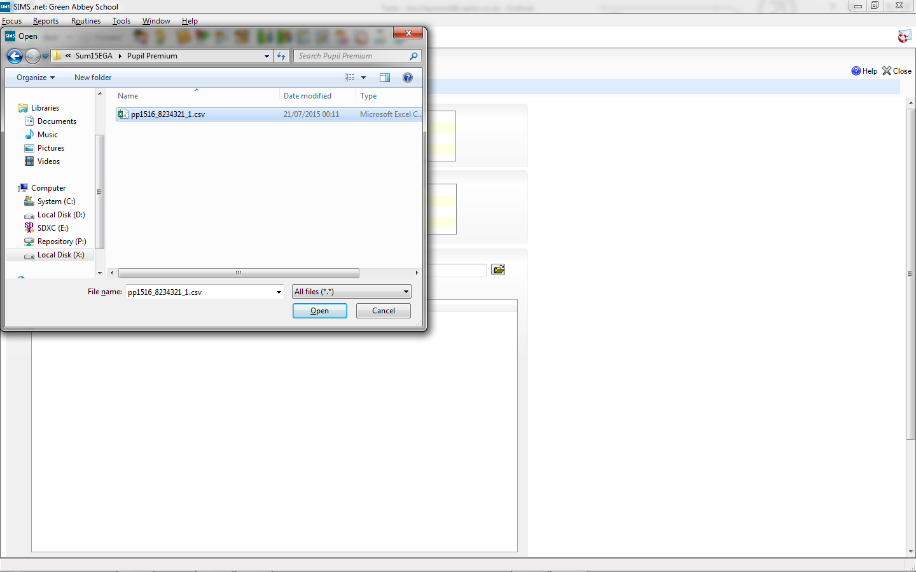

Slide 13
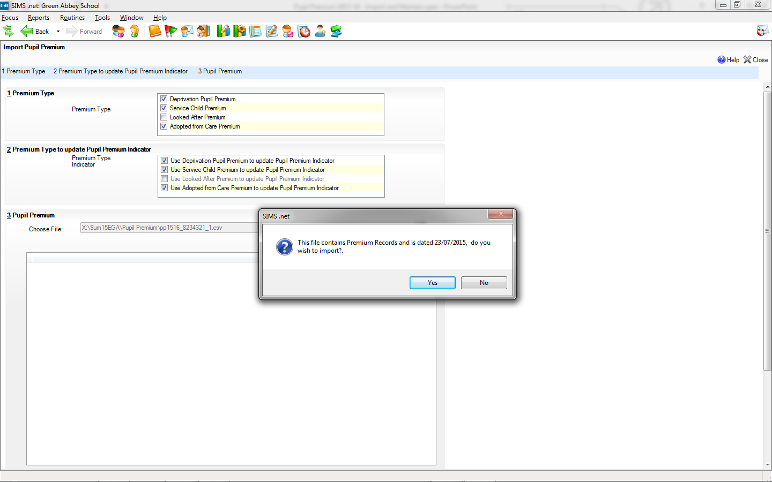

Slide 14
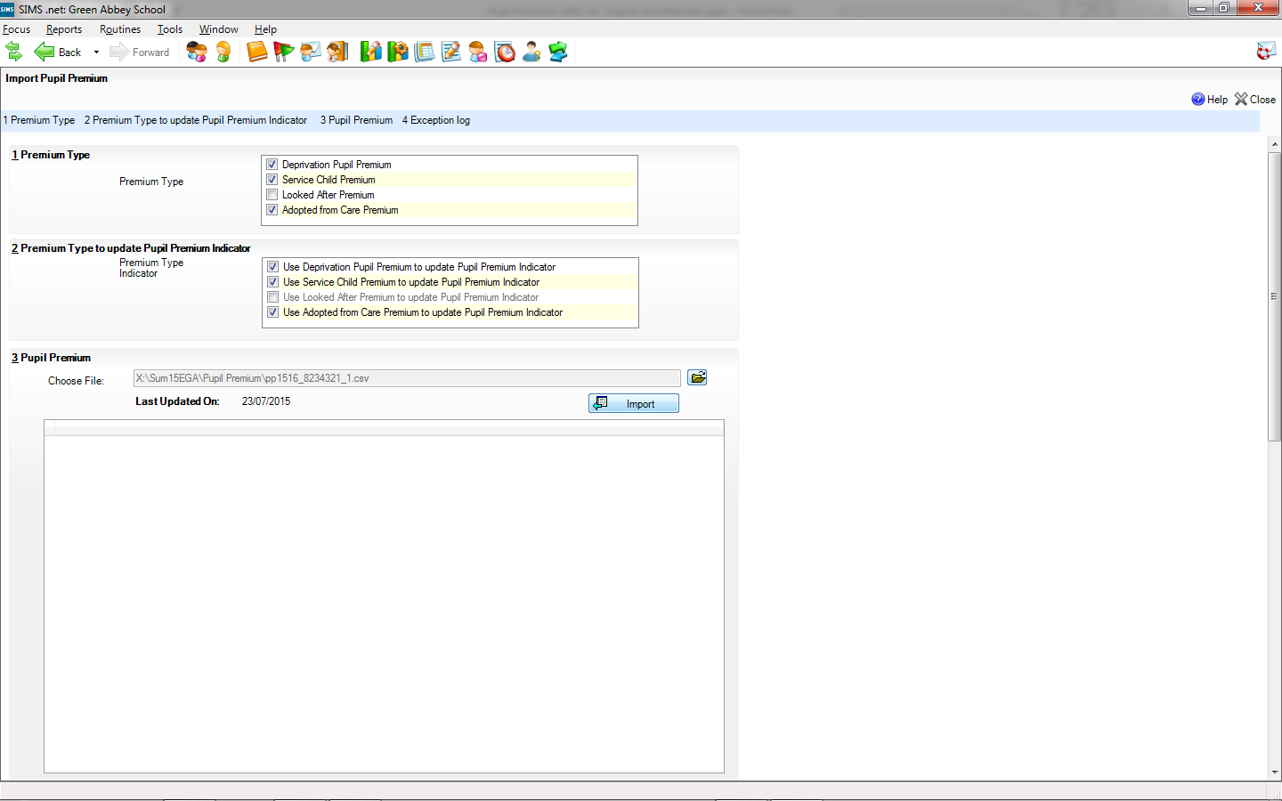
Once we are happy that we have selected the right file, we tick import to bring the information in from the file.

Slide 15
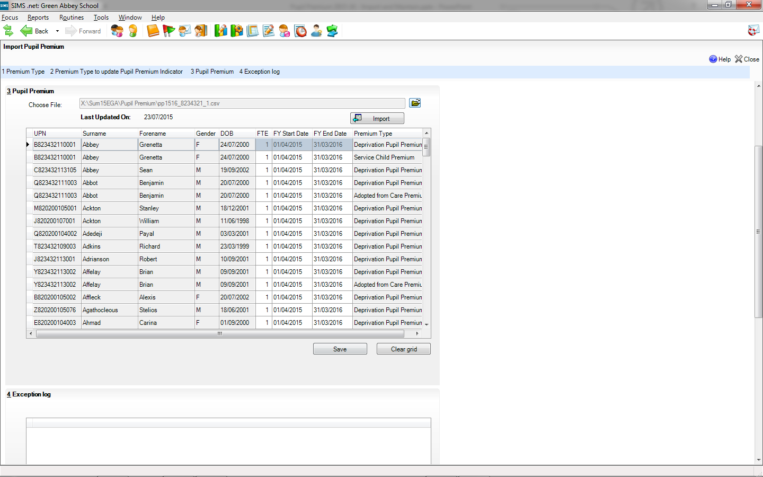
Grenetta, Abbey has two different Premium Types so this is display as two rows in the table

Slide 16
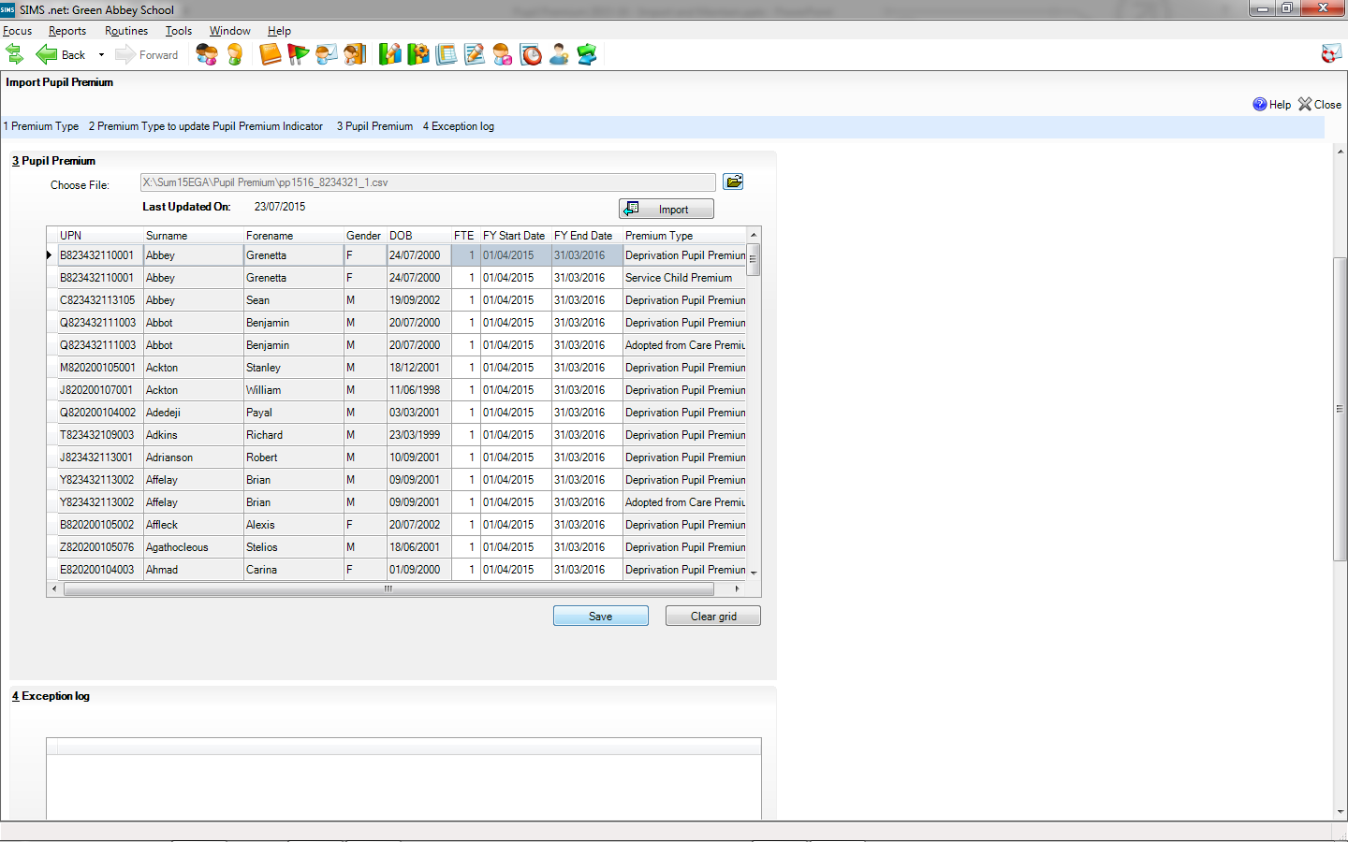
At this point the information has just been added to a temporary table and we must click Save to add this to the “real” tables

Slide 17
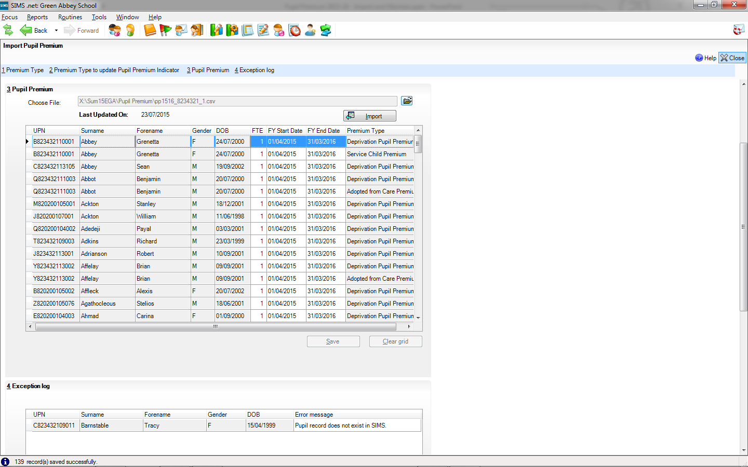

Slide 18
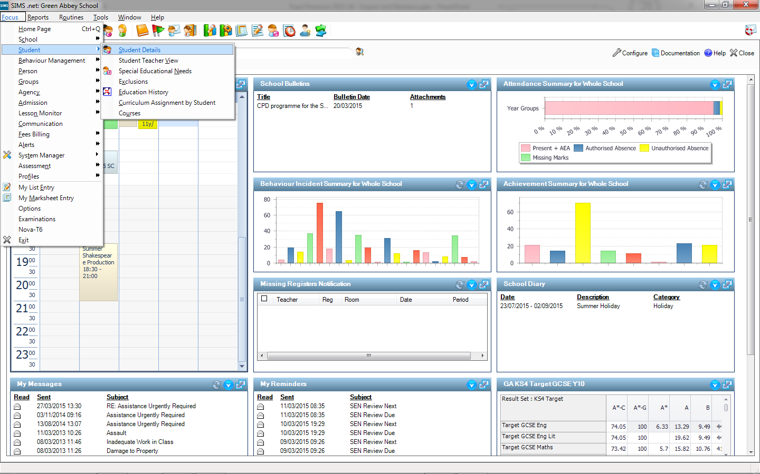
We can check the Pupil Premium Indicator for Grenetta Abbey in Student Details

Slide 19
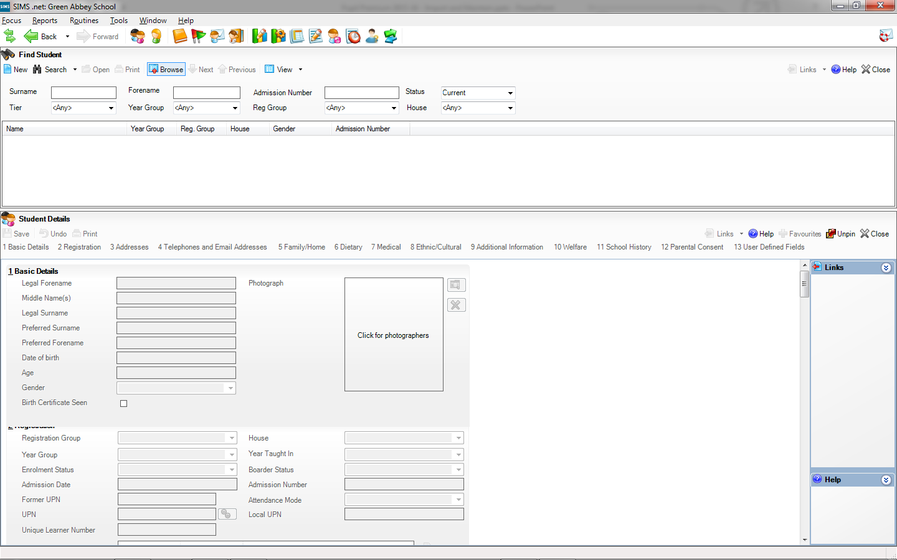

Slide 21
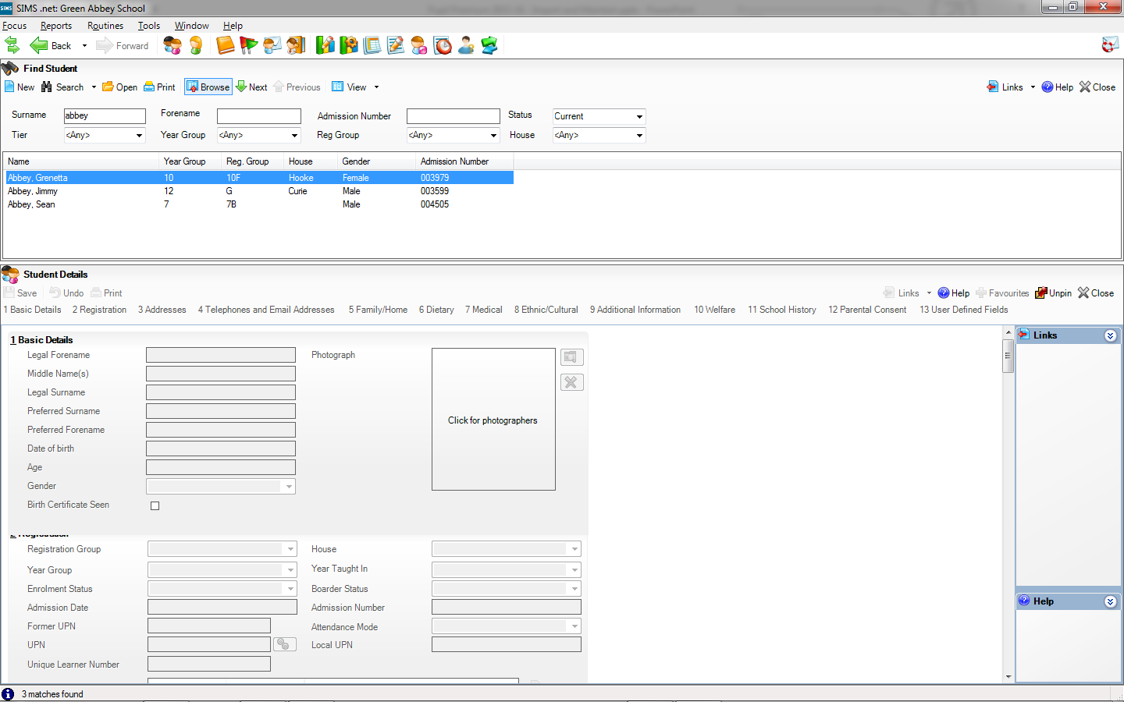

Slide 23
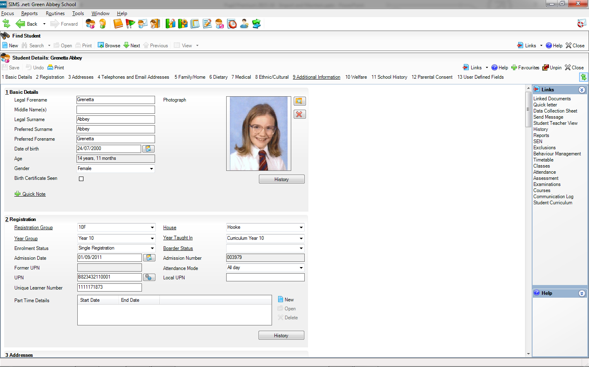

Slide 24
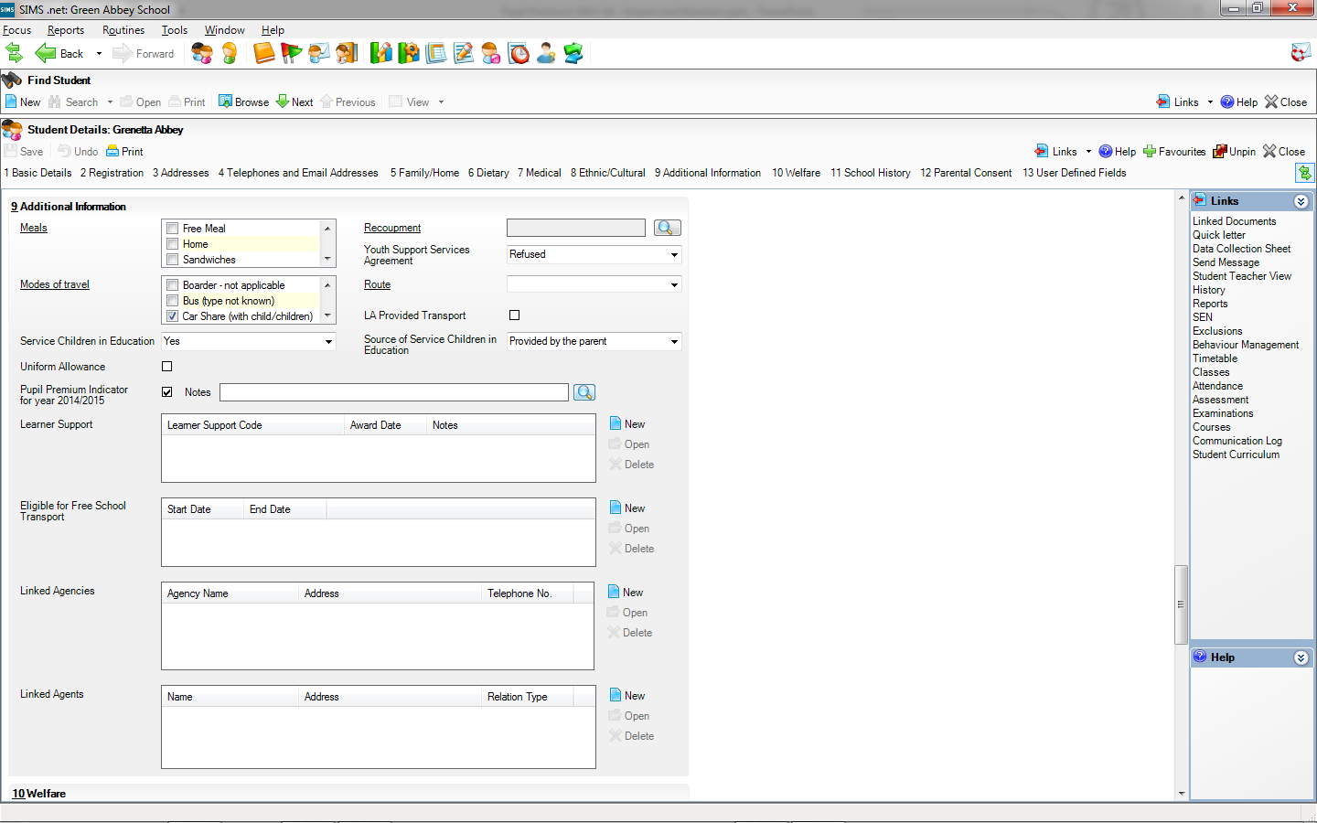

Slide 25
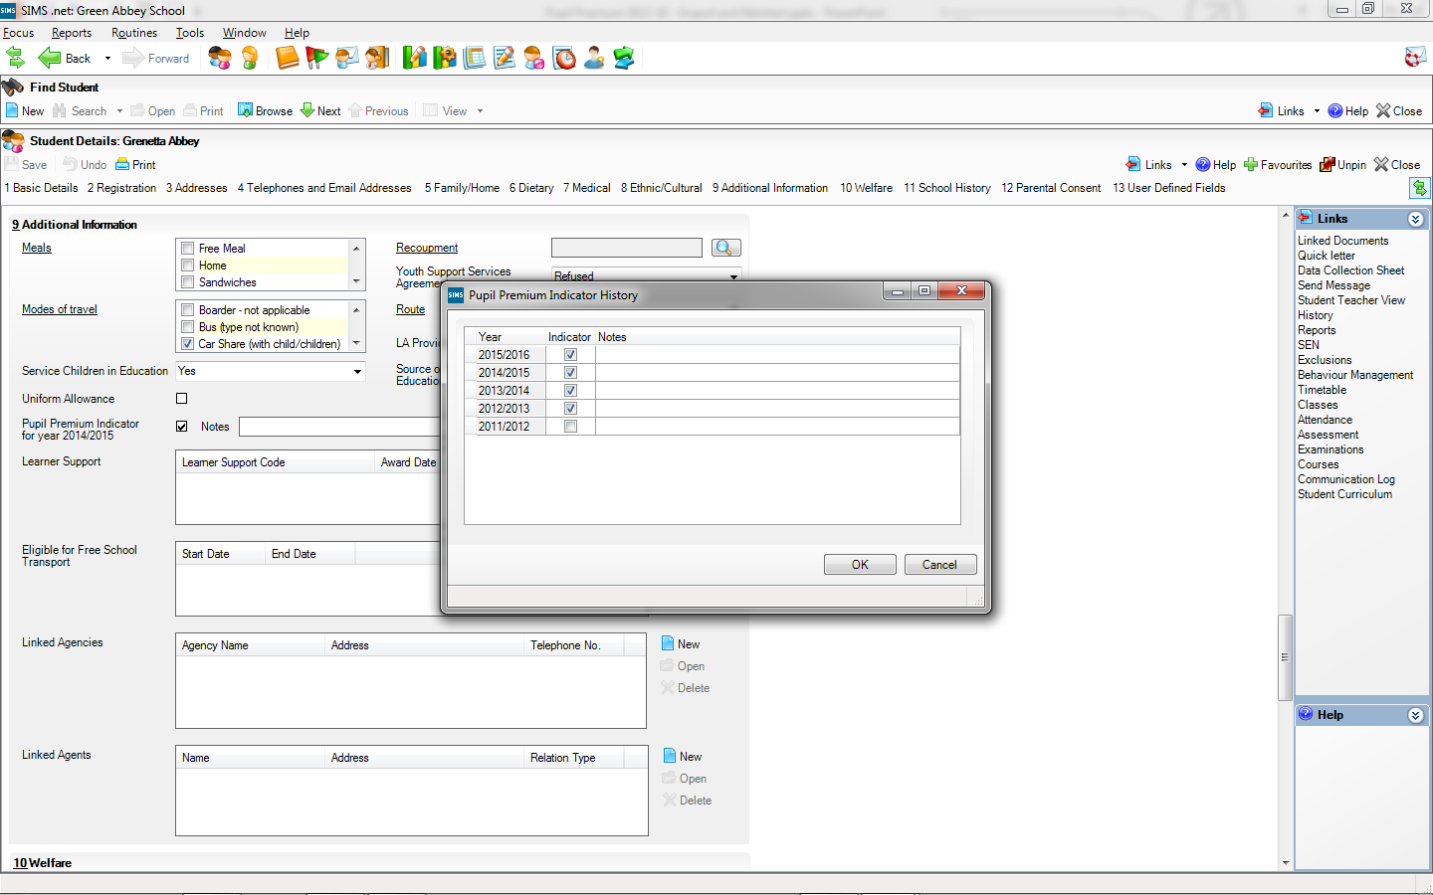
The ticks are as we expect as a financial year crosses two academic year

Slide 26
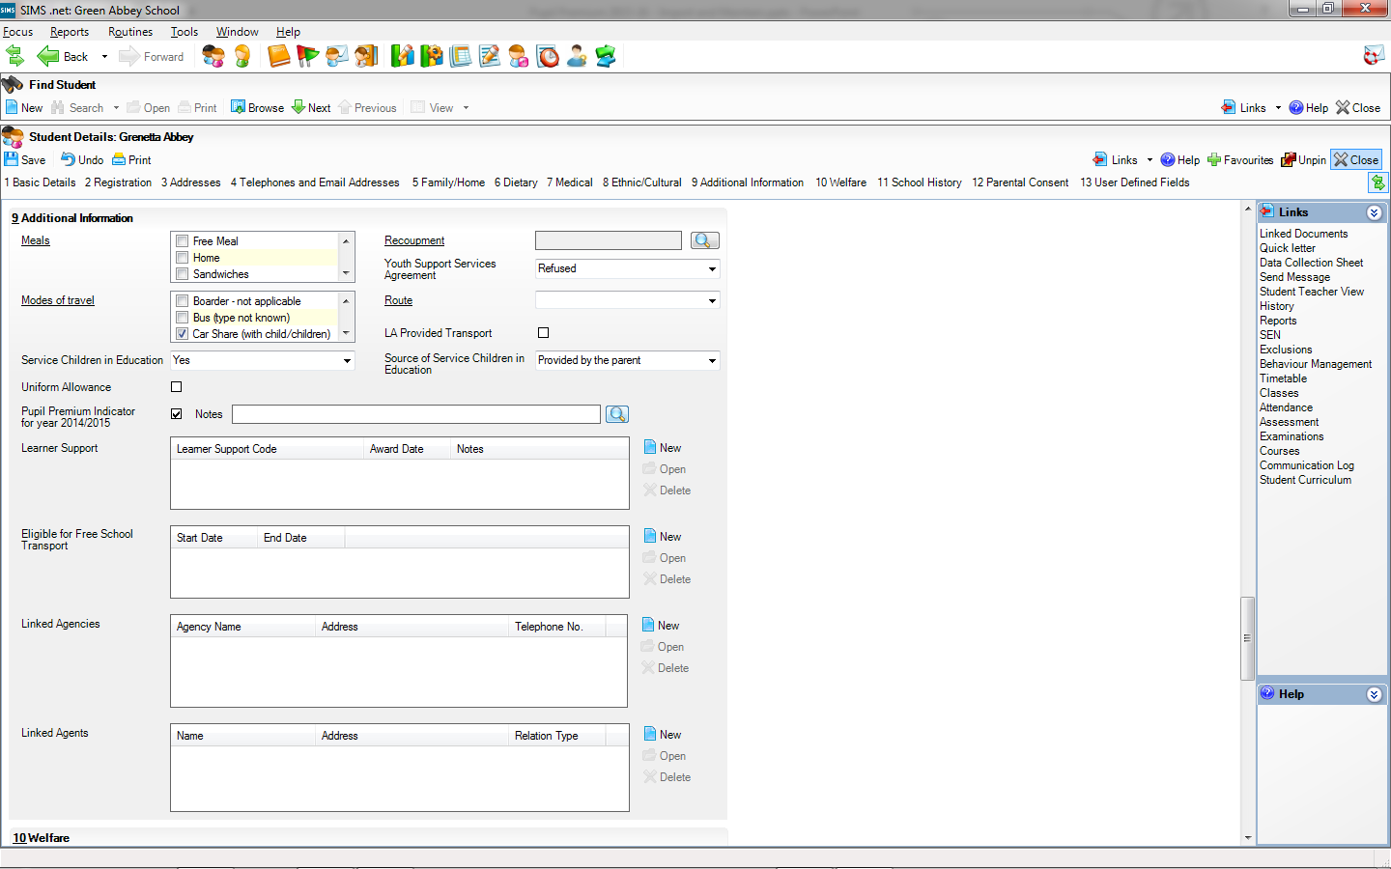

Slide 27
Maintaining Pupil Premium information

Slide 28
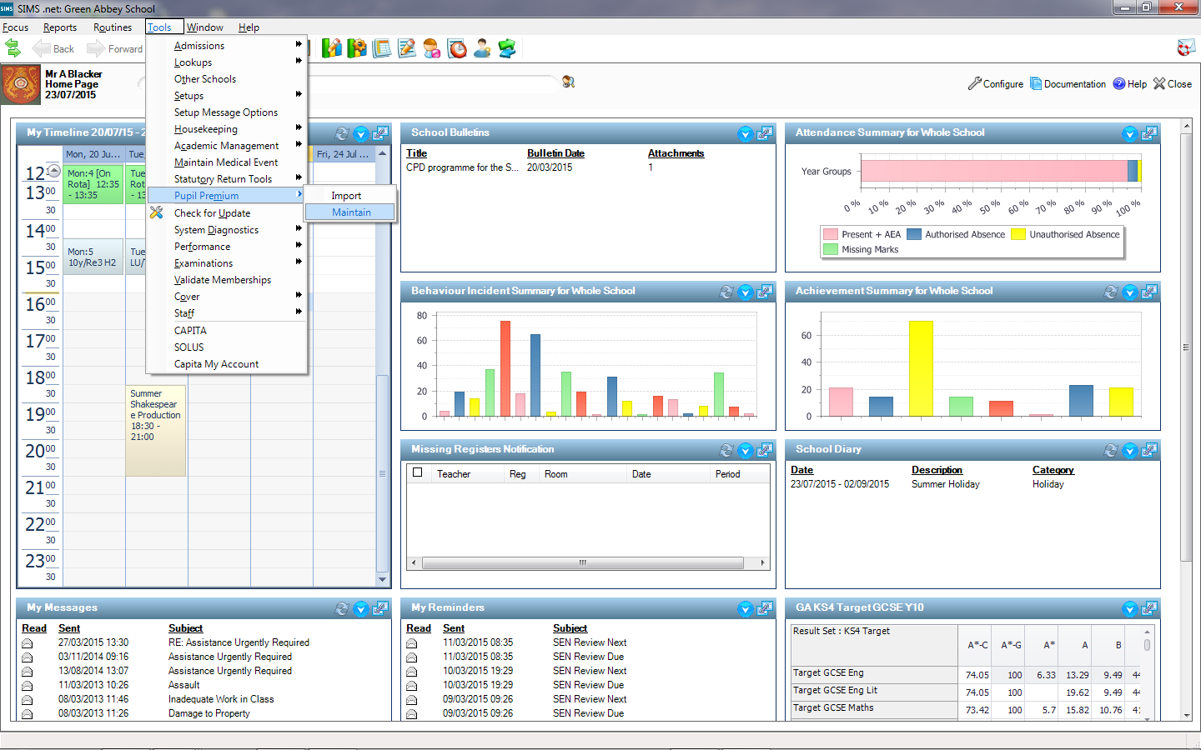

Slide 29
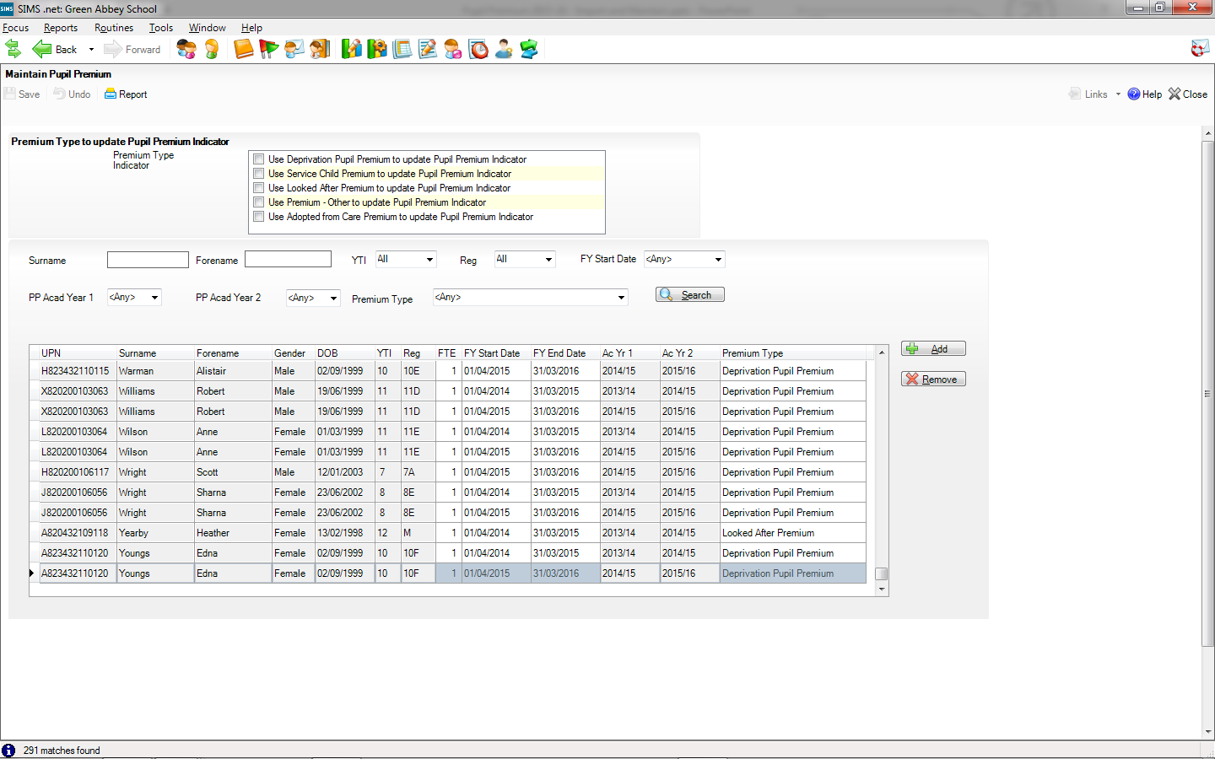
By default saving Maintain Pupil Premium information will not update the Pupil Premium Indicator, but we can add ticks for each Pupil Premium Type as desired.

Slide 30
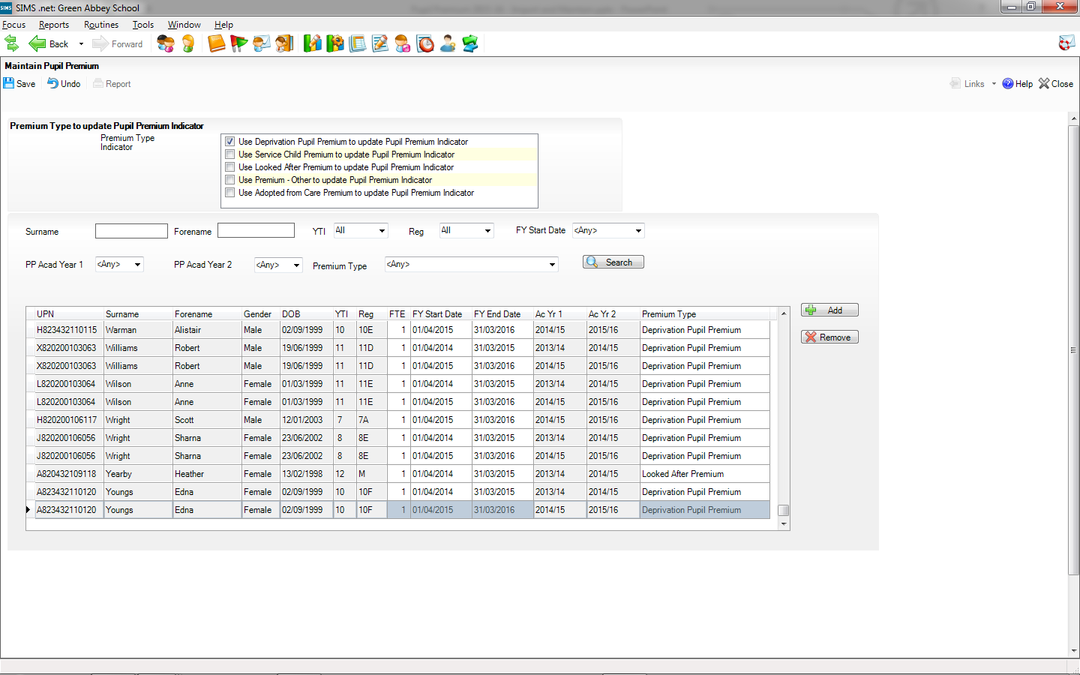

Slide 33
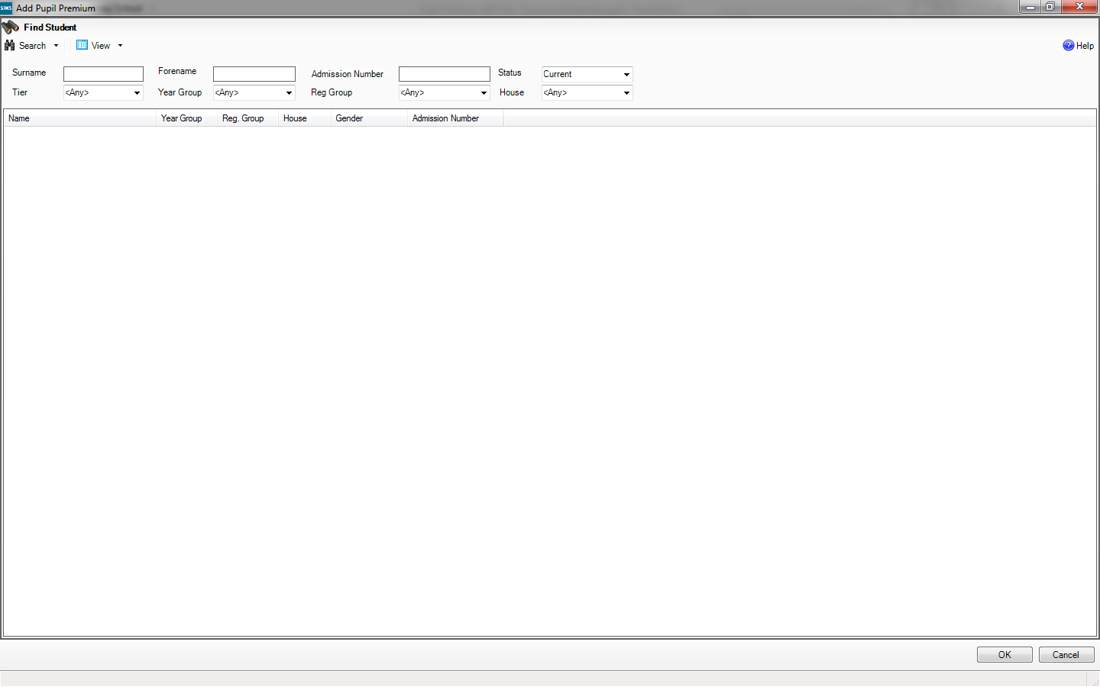

Slide 34
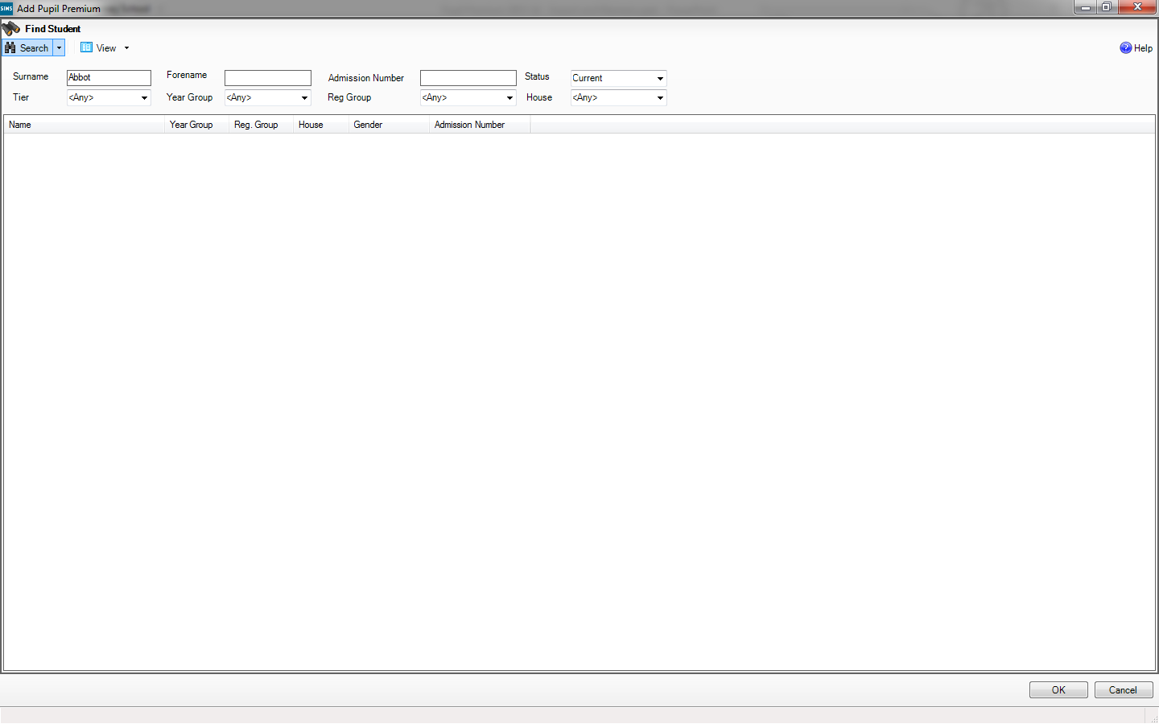

Slide 35
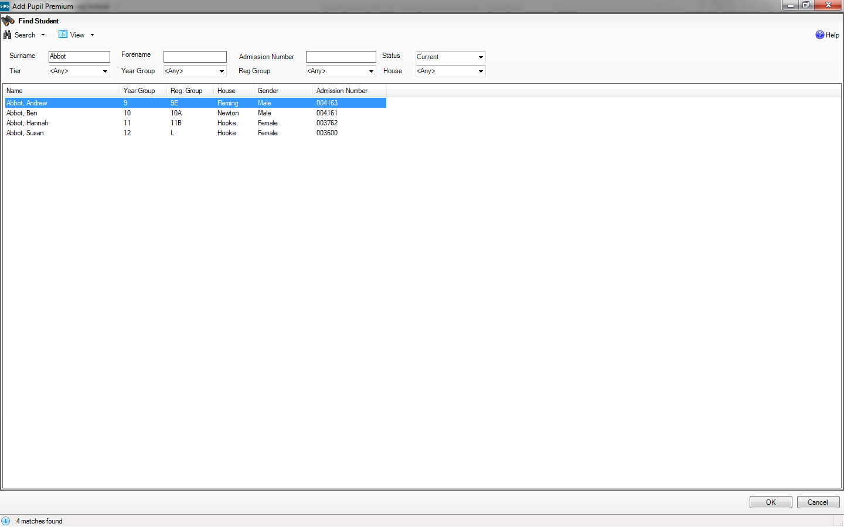

Slide 37
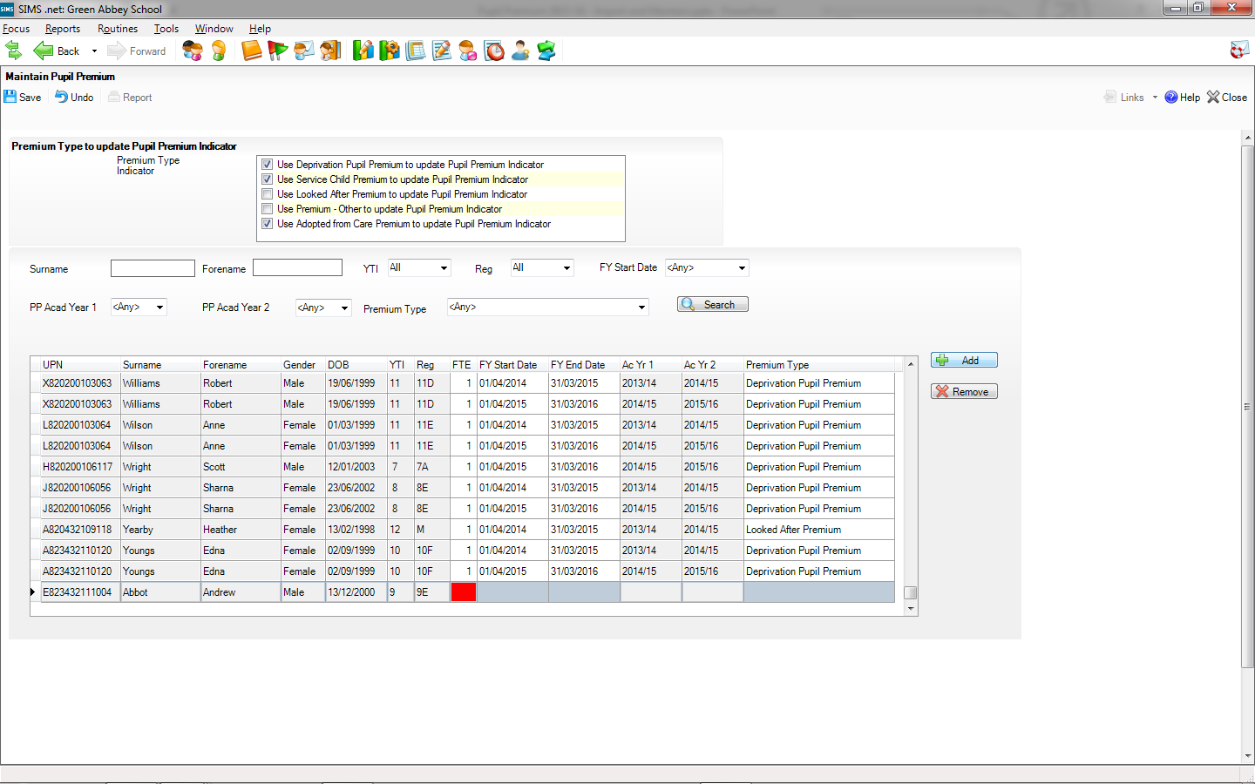

Slide 38
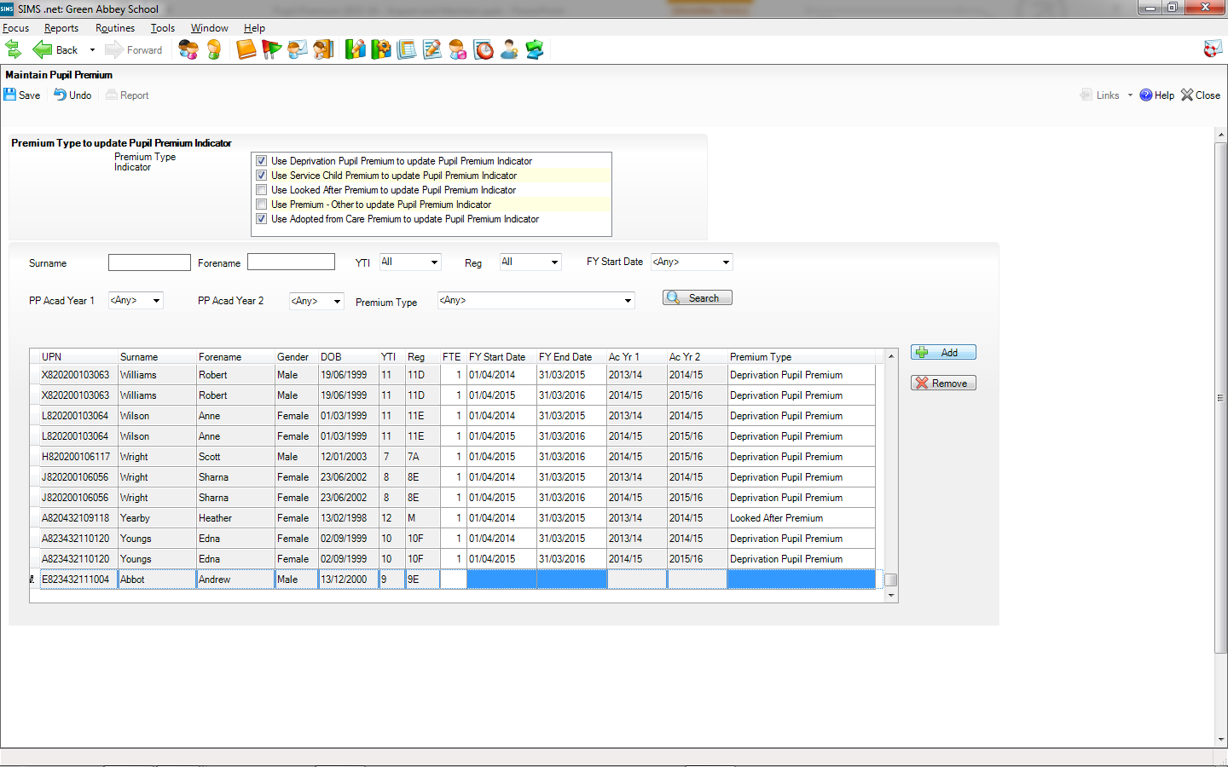

Slide 40
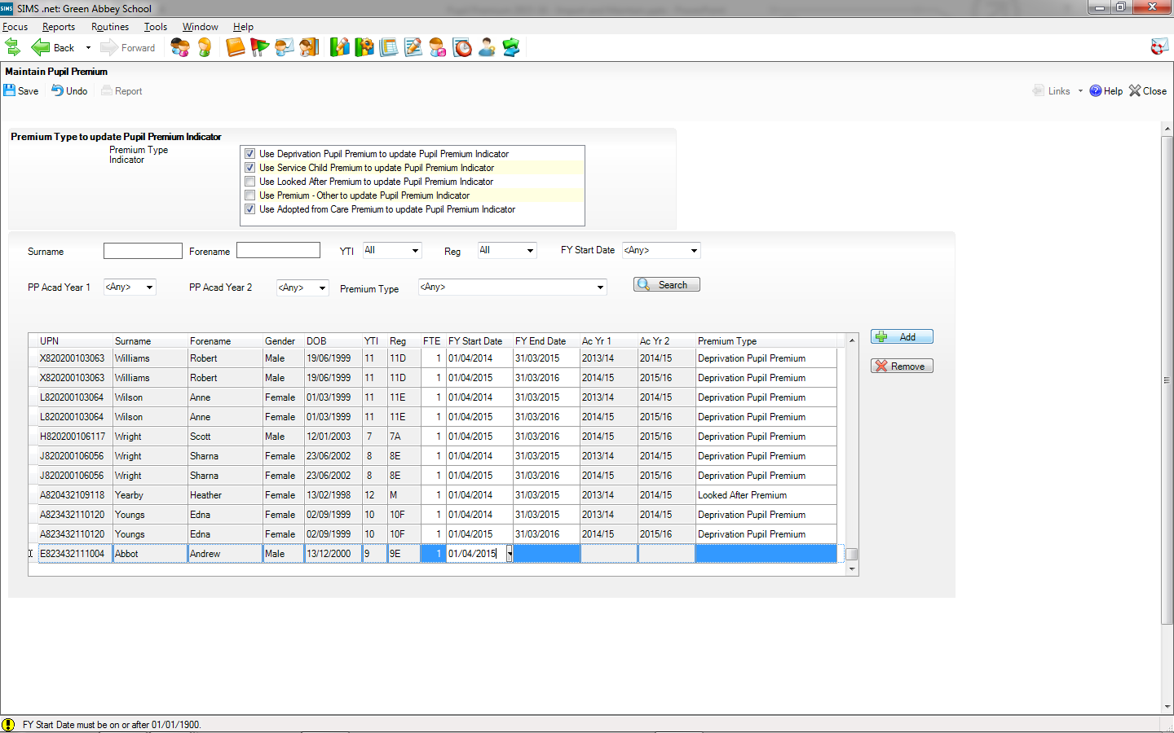

Slide 41
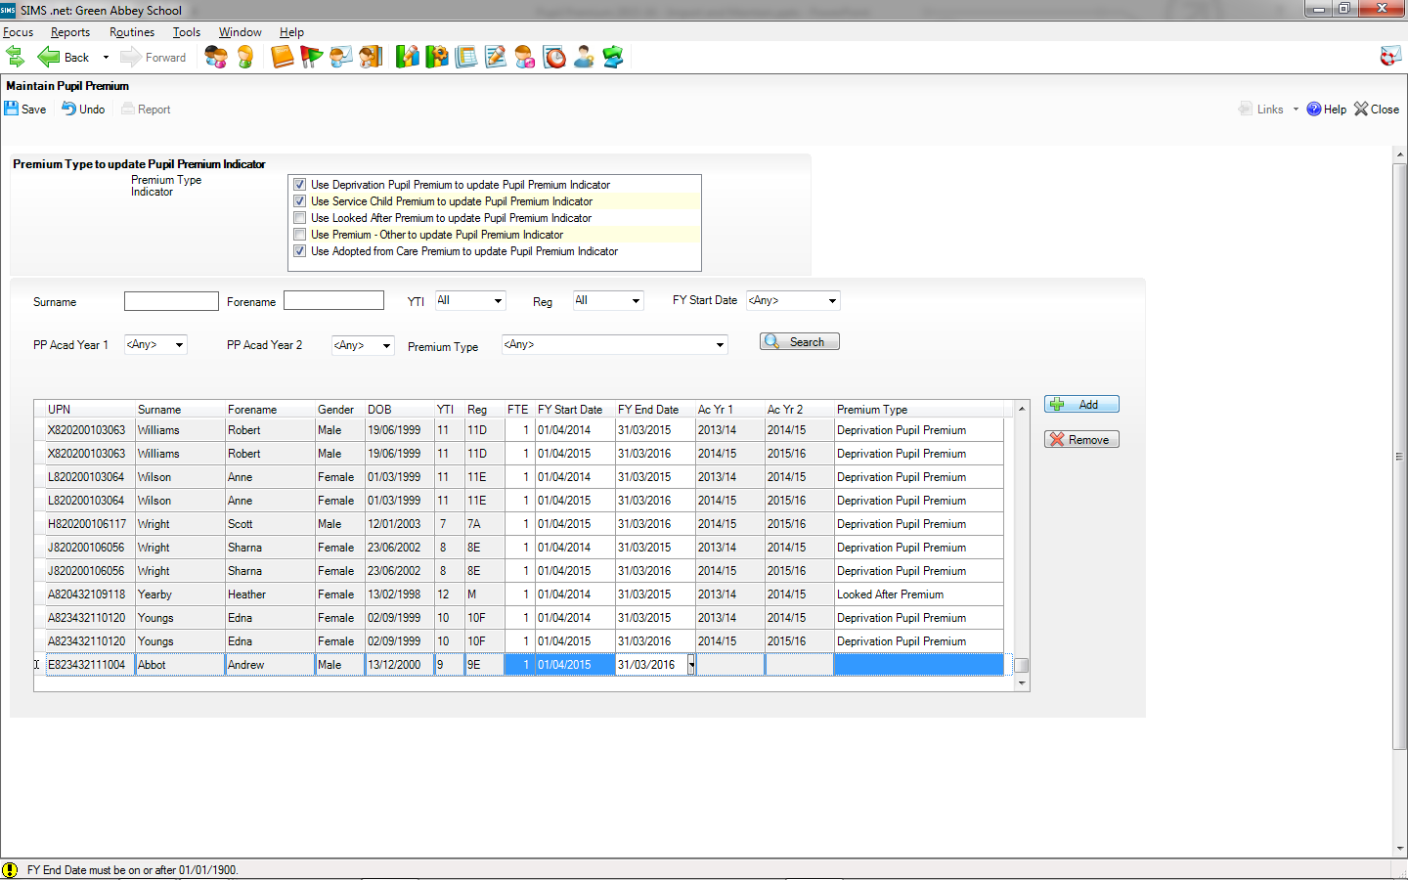

Slide 42
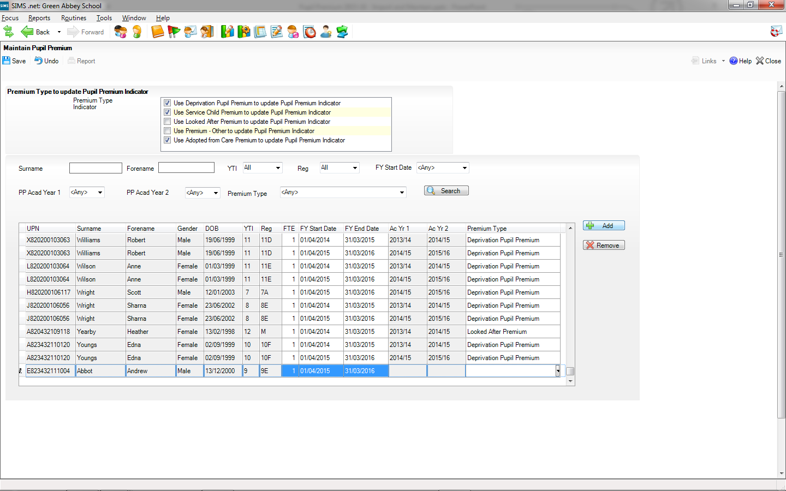

Slide 43
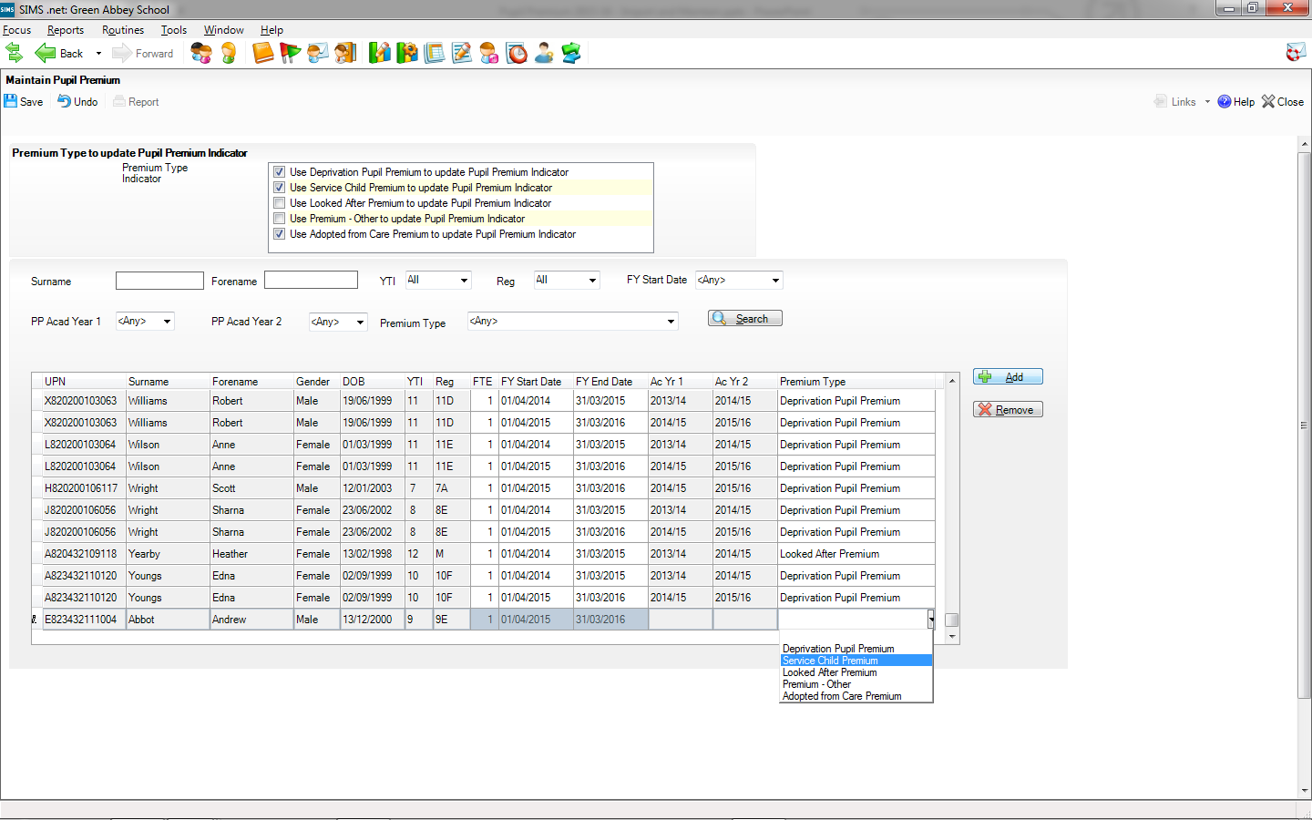

Slide 44
We don’t fill in the Academic Years, as the application will use the Financial Year start and end dates to calculate this for us.

Slide 45
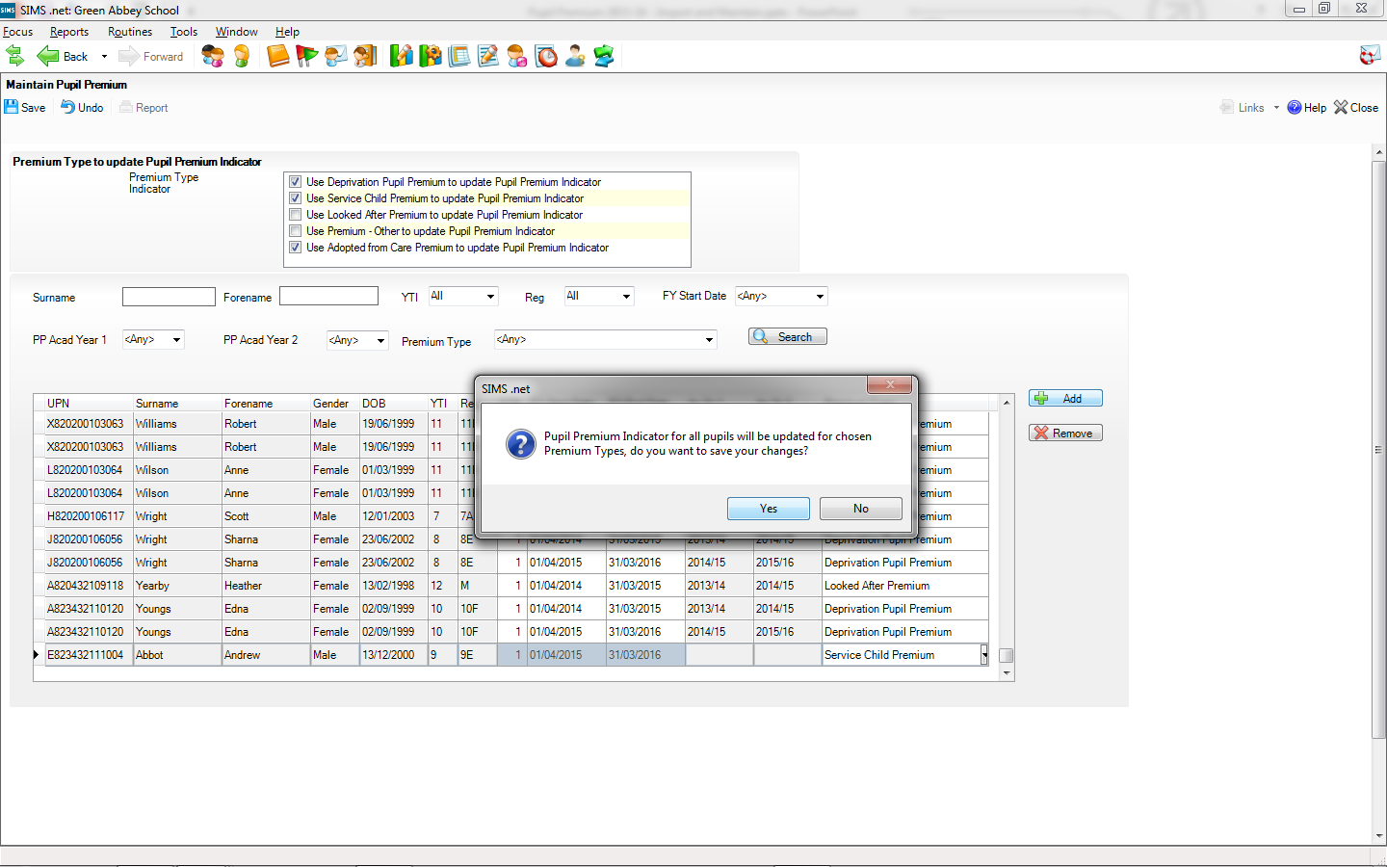

Slide 46
