Slide 1
SIMS Reporting Enhancement supporting GDPR
Person Data Output
(PDO)
Paul Featherstone, Product Manager

Slide 2
Data Protection Act and General Data Protection Regulation
The Data Protection Act (DPA) (Principle 6) gives rights to individuals in respect of the personal data that organisations hold about them.
Part of this right is for an individual to see a record of the information an organisation holds about them, this is commonly referred to as a Subject Access Request (SAR).
The General Data Protection Regulation takes some elements of the DPA further, please see the ICO website for details.

Slide 3
Understanding a Subject Access Request
A SAR can be for specific data, i.e. sessional attendance information for the academic year 2016/2017, or all the behaviour events for the Summer 2017 school term.
A SAR could also be every piece of information the school holds on that subject.
It is not just data held in SIMS that you need to worry about, what else is stored in your filing cabinets (original paper application forms), in spreadsheets and other documents stored on a network drive.
Additional notes in a teacher’s notepad.

Slide 4
How can SIMS help?
When a SAR is made by a person it’s clear that SIMS cannot and does not legally have to provide a single report to deliver everything.
It’s absolutely acceptable under the DPA and GDPR (as confirmed by the ICO) for a SAR to be made up of multiple reports from SIMS.
The new Person Data Output has been developed to make the process for a school easier and quicker when fulfilling the requirements for a SAR.

Slide 5
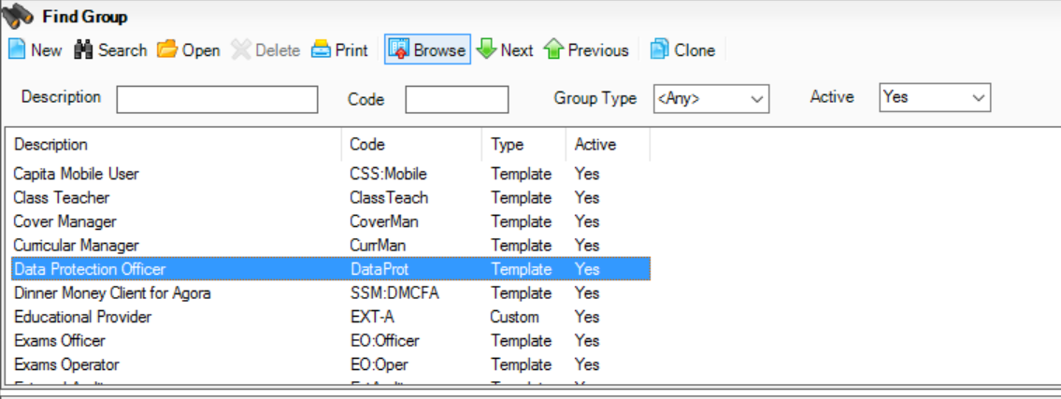
Permissions Required for PDO
A new permission group called Data Protection Officer has been created

Slide 6
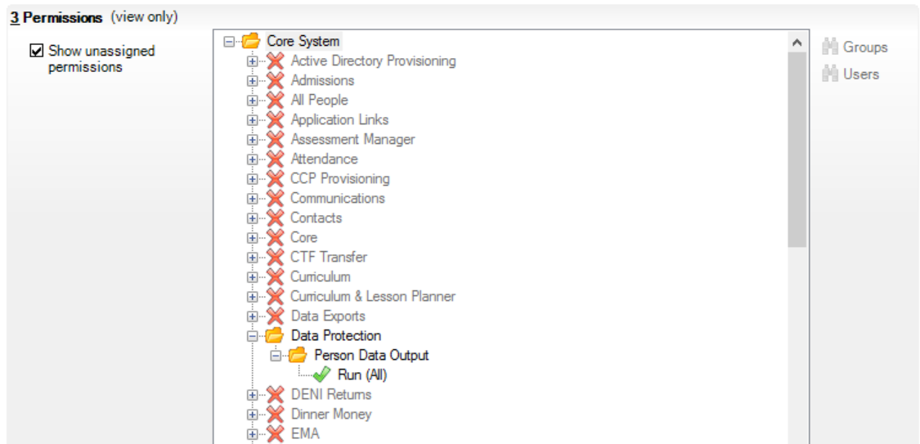
Permissions Required for PDO
By default upon upgrade no users are added to this group, nor is the single permission added to any other existing group

Slide 7
Running the PDO
As functionality extends in future releases to allow for data portability (machine readable outputs), it’s was clear that this is going to be more than a report.
To generate a PDO select Routines | Data Out | Person Data Output.
The screen will show an audit log of all previously generated outputs detailing when, on whom, created by, original save location and notes collected at the point of creating the file.

Slide 8
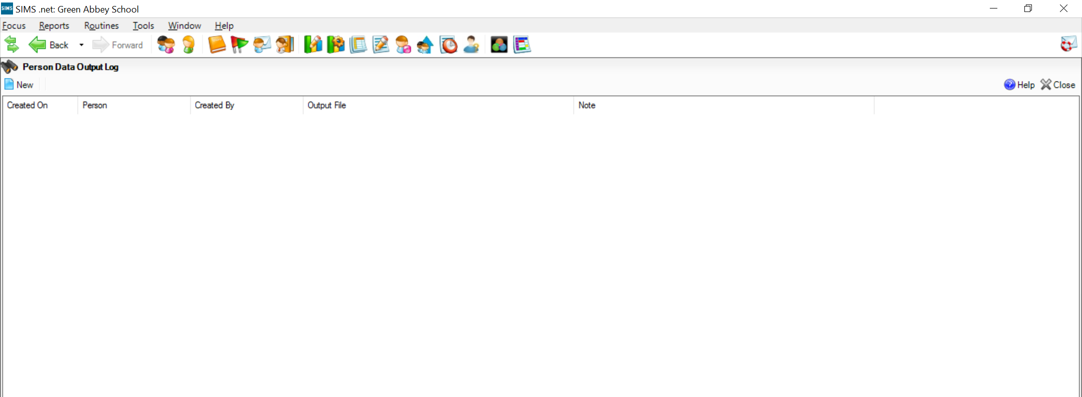
Running the PDO
Click on New to generate a new output.

Slide 9
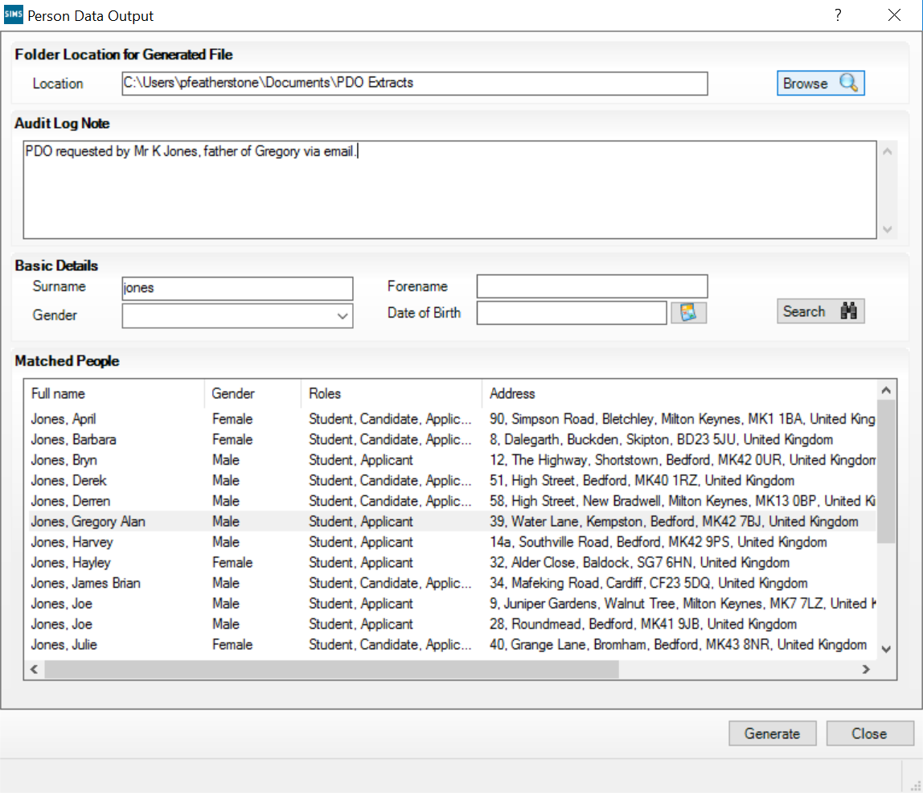
Running the PDO
The user must select a location to save the PDO file and ensure it is secure and appropriate location.
Suitable notes can be entered here in relation to the PDO.
For this first release Students will be the focus of the search, later releases will allow for the search for Staff, Contacts and more.
Select the person on whom you want the extract the data. Initially the output will contain Student (not applicant) data.

Slide 10
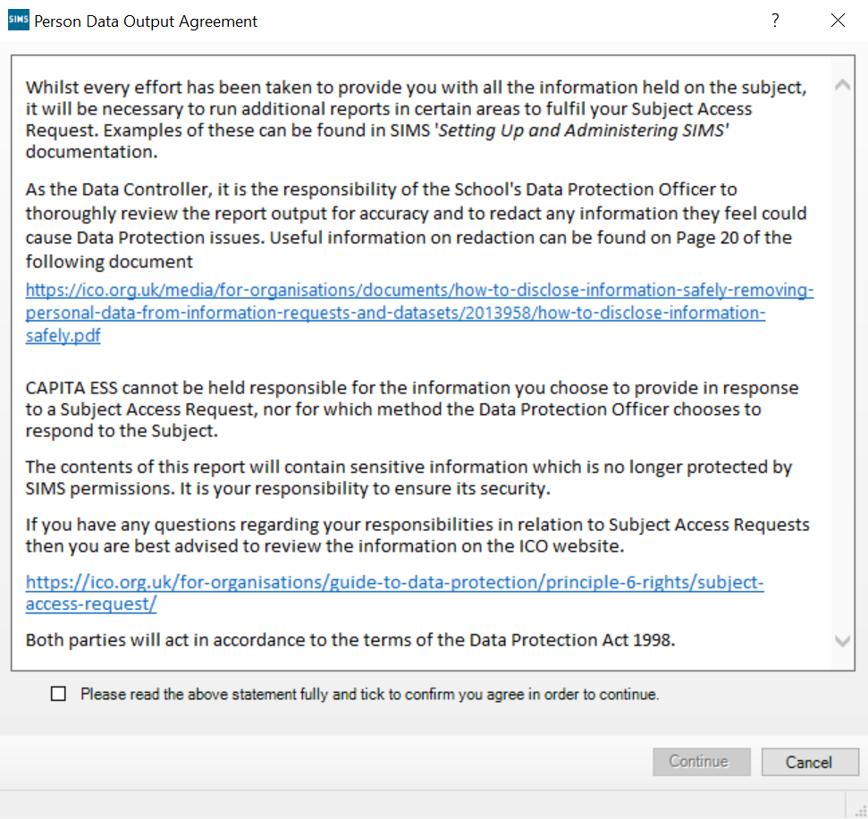
Terms and Conditions for the PDO
Guidance for running additional reports.
Check, check and double check the output before returning to the subject.
Useful guidance of redaction.
Data contained in this output can be of an extremely sensitive nature and could cause safeguarding concerns.
Very useful information available on the ICO website.
You cannot run the output until you agree to the terms and conditions.

Slide 11
Summary of the PDO
Output will open as a MS Word (.docx) file.
Detail such as individual sessional attendance (i.e. each individual mark) is not provided, but a summary for each academic year is given.
Where other areas such as Dinner Money or Fees Billing are used, the PDO provides a summary of data.
In these cases, where SIMS provides comprehensive more detailed reports, i.e. attendance certificates or dinner money transactions, we recommend you supplement the PDO with reports already available in SIMS.

Slide 12
Keep up-to-date with SIMS... Be first to hear our news about our latest developments by signing up to our newsletter – www.capita-sims.co.uk/stayintouch. Visit www.capita-sims.co.uk for everything you need to know about SIMS, including our extensive training calendar, webinars and upcoming events and conferences.
@CapitaSIMS

