Slide 1

Using Interventions as a teacher or teaching assistant
Lucy Crawford (Product Manager)

Slide 2

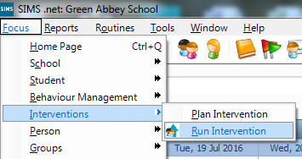
How to get started
You can get to the Interventions module using the quick link:
You can also use the menu route: Focus | Interventions | Run Intervention:
If you can’t see either of these routes, please contact your Data manager, or SIMS coordinator*
Notes:
*note to SIMS co-ordinators, data managers:
If you are taking part in the pilot, please ensure that you have upgraded to the SIMS Autumn 2016 release, and applied the licence patch
If you are not taking part in the pilot, please ensure that you have upgraded to the SIMS Spring 2017 release
If your teachers or teaching assistants are unable to see these menu routes, they may need the appropriate permissions adding in system manager

Slide 3
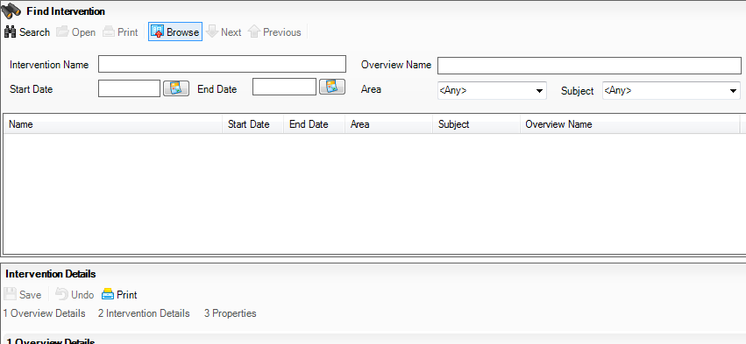
Finding your Interventions
You will see the following screen, press search to see a list of Interventions that you have been added to:

Slide 4
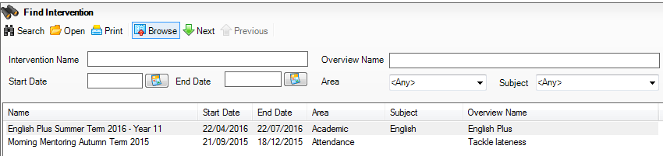
Finding your Interventions
The list will show the latest Interventions at the top. You can also filter by any of the other options at the top and press Search again.
Double click on the Intervention that you want to open it.

Slide 5
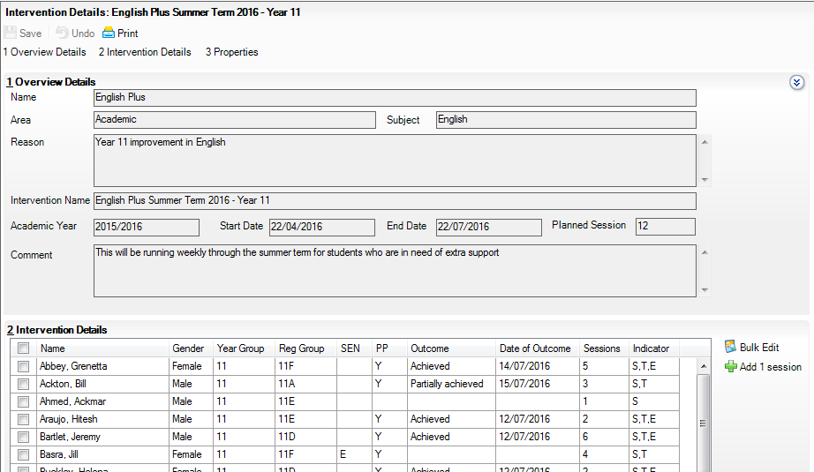
Adding information to your Interventions
When you first open up the screen, it will give you details about the Intervention as well as the students on it. You can minimise the first panel if you want to.

Slide 6
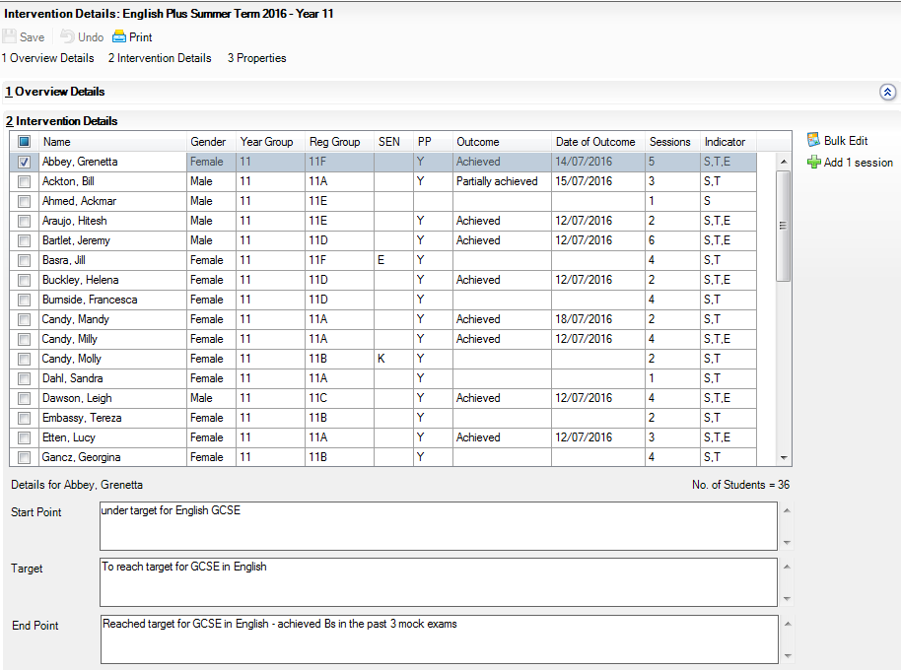
Viewing information about your students
Click on any name in the grid to see information about them:

Slide 7
Adding information about individual students
Add in the number of sessions the student has attended, by typing
Increment the number of sessions that the selected student has attended by clicking this button
Drop down the outcome to fill in how successful you feel the intervention has been for that student
The Date of Outcome will automatically fill in today’s date when you enter an Outcome, but can be changed
This shows whether or not the student has a Start Point, Target and End Point filled in
Add in the student’s final achievement point
Notes:
This slide needs regionalisation for England, Wales/NI and Independent schools

Slide 8
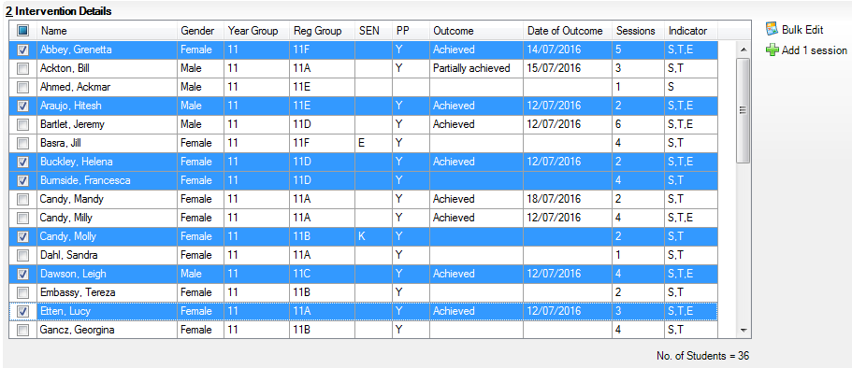
Adding information about students in bulk
Tick the boxes down the left hand side to highlight multiple students. Clicking the top left box will select and deselect all students in the grid.

Slide 9
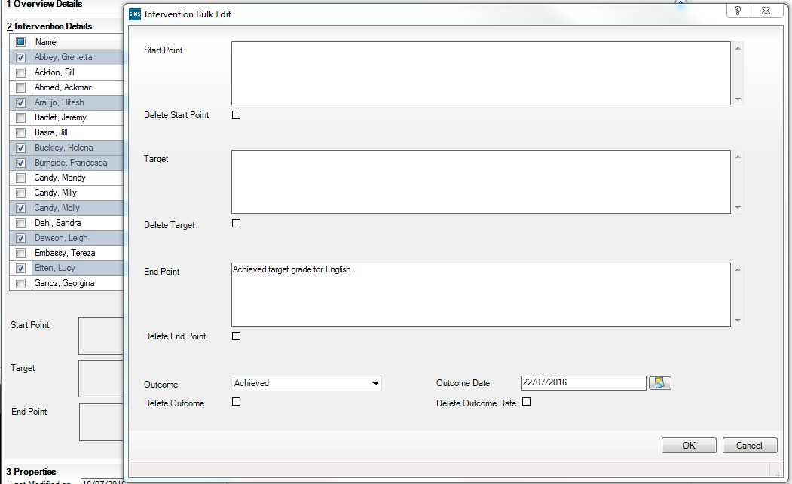
Adding information about students in bulk
Add in End Points and Outcomes from this screen for all of the selected students. Please note, entering data into this screen will overwrite any existing text.

Slide 10




0800 170 1734
info@capita-sims.co.uk
www.capita-sims.co.uk
Follow us on Twitter @CapitaSIMS

