Slide 1
Interventions in SIMS
Lucy Crawford

Slide 2
What are Interventions? How do they affect schools?
Interventions are anything that schools are doing above and beyond the national curriculum to help improve outcomes for their students.
Examples could be to improve grades, attendance, behaviour or general wellbeing.
Notes:
Philippa to add in context related to Ofsted and Interventions
Do we want to mention something about the new Welsh ALN code of practice?

Slide 3
The attainment gap
Over 1.4 million (21%) children aged 4-15 are eligible for free school meals in this country. They will start primary school behind their better-off classmates - and this attainment gap will increase throughout their schooling.
The latest figures show just 37% of disadvantaged children achieved 5 good GCSEs, including English and Maths, compared to 63% of all other pupils. Children from poorer backgrounds do worse on average than their wealthier classmates whichever type of school they are in.
The attainment gap between rich and poor pupils is particularly stark compared with other OECD countries.
Young people with poor educational attainment are much more likely to end up not in education, employment or training (NEET).
(Education Endowment Fund 2016)

Slide 4
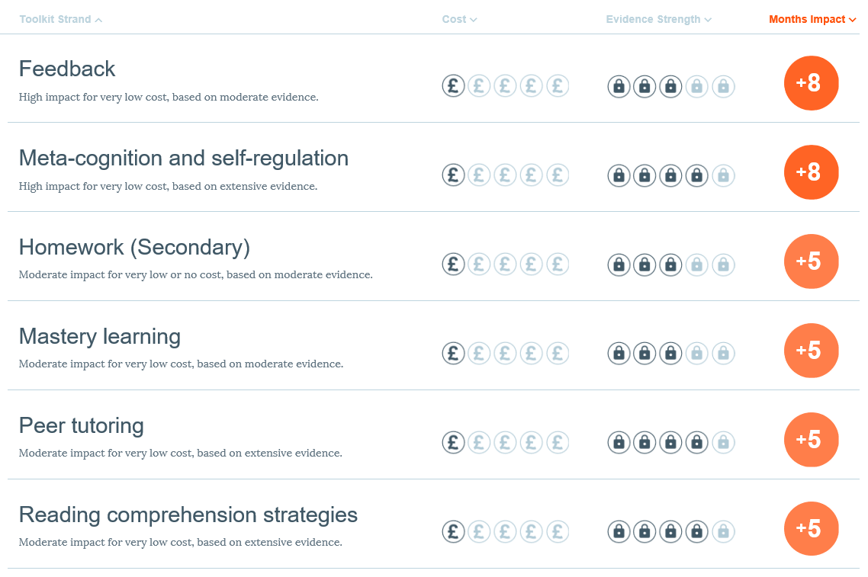
EEF Teaching & Learning Toolkit
Notes:
Education Endowment Fund 2016

Slide 5
What is Interventions in SIMS?
New module
Integrated in SIMS7 Core
Planned to be part of annual entitlement
Currently in development
Due in Spring 2017
Pilot in Autumn 2016
Notes:
Will be included in ISMS primary later in 2017

Slide 6
Pilot of Interventions Module
Piloting with schools in the Autumn release to ensure robustness
Available via a licence patch to pre-agreed schools (already signed up)
Licence patch can be run on Green Abbey and Waters Edge and will be available to all Support Units
Supporting documentation on Interventions will also be made available to Support Units via MyAccount

Slide 7
What will Interventions do?
Improve student outcomes
Find underperforming students
Allocate support and resources
Track improvements and costs
Notes:
SIMS Interventions will be a system to use the power of SIMS to track underperforming students, allocate additional support and resources to those students, and track how those resources affect KPIs, as well as how much those resources cost, from a central area, so that outcomes can be tracked against cost.

Slide 8
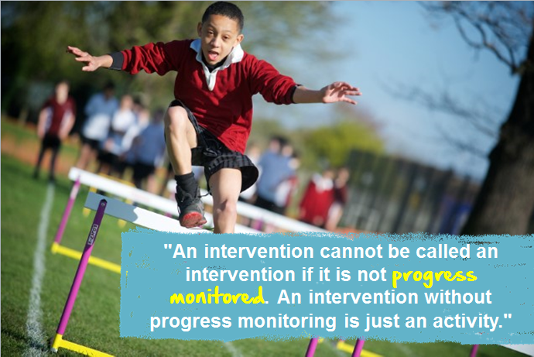
Notes:
Focussed on reporting to help support schools with progress monitoring

Slide 9
Key parts of SIMS Interventions
Reporting
Intervention definitions
Student memberships
Student details

Slide 10
Recording Interventions

Slide 11
Recording Interventions in SIMS
Interventions in SIMS has two key areas:
Plan Intervention
Run Intervention

Slide 12
Plan Interventions

Slide 13
Two key areas to access
Plan Intervention
Run Intervention

Slide 14
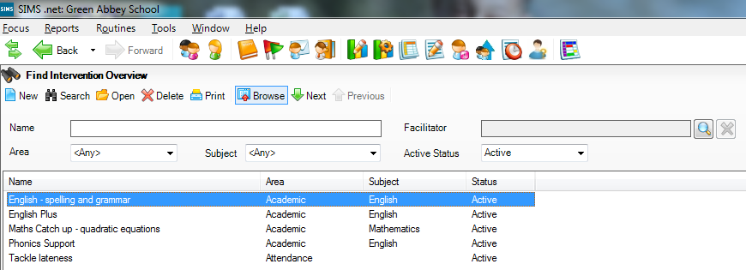
Plan Intervention - create and edit
Focus | Interventions | Plan Intervention
Find existing and create new Interventions

Slide 15
Plan Intervention – Intervention overview
Enter general Intervention information once
Use many times
Group Interventions together
Notes:
Name - is free text – add in anything you want into here – complete flexibility
Area – what you want to measure the success of the intervention against – 5 options: Academic, Attendance, Achievement, Behaviour, Other
Subject – picks up from your existing subject list – no need to set up again
Reason – more free text to describe exactly what the intervention is for
Active flag – if you no longer want to use the intervention, but still want to keep the historical data

Slide 16
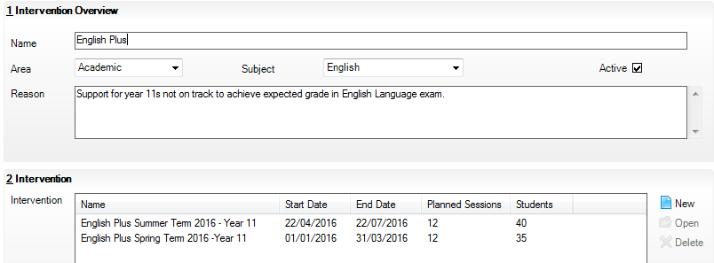
Plan Intervention – Intervention dates
Group all the times you carry out an Intervention together under an overview
Notes:
This also means that you can enter in the information in the overview area once, and use as many times as you like, as well as making it easier to find interventions that are the same that were run at different times of the year.

Slide 17
Plan Intervention – recording dates
Add in information about the actual time periods over which you want to run the intervention
Notes:
Name – is also free text, complete flexibility to put what you want in here. This is what teachers will see when they are looking for an intervention, so it is best to keep it descriptive.
Academic year – can be selected when you first go in, but can’t be changed after the first save. Will affect the start and end dates that you can select
Start Date and End Date – select any date that you want
Planned Sessions – this will allow you to give a suggestion of how many times this intervention should be run, if it is the kind of intervention that needs individual sessions. This can also be set to 0.
Fixed Costs – any upfront costs that the intervention may require, e.g. equipment, purchase of software, any other costs
Staff Costs per session – how much you are paying the member(s) of staff per session. None of the cost fields have to be filled in, and some schools may decide to only use this field for interventions being run by someone outside of school.
Other costs per session – any other ongoing costs
Total costs – (planned sessions x (staff costs + other costs)) + fixed costs. Calculates automatically.
Cost fields have their own set of permissions attached to them, and can be changed accordingly.
Comment - any other notes on the intervention

Slide 18
Plan Intervention – Add students
Chosen groups
Find individual students by searching for their Forename or Surname
Filter by Gender
Tick to Select students
Click Apply to select the students onto the Intervention
Click ‘Select All’ or ‘Deselect All’ to bulk select
Notes:
The groups pick up as at the effective date and have been added in to help schools find students who are most likely to need an intervention as easily as possible. There is a wide variety of groups, including pupil premium, FSM, SEN, G&T and many more.
Tick as many or as few groups as you want, then click populate. You can also find individual students using the surname and forename filters, and also filter by gender.
Clicking on the titles of the bottom grid allows you to sort by that attribute. Tick as many or as few students as you want to include, or click Select All to tick all names. Once you are happy with your select, click apply.

Slide 19
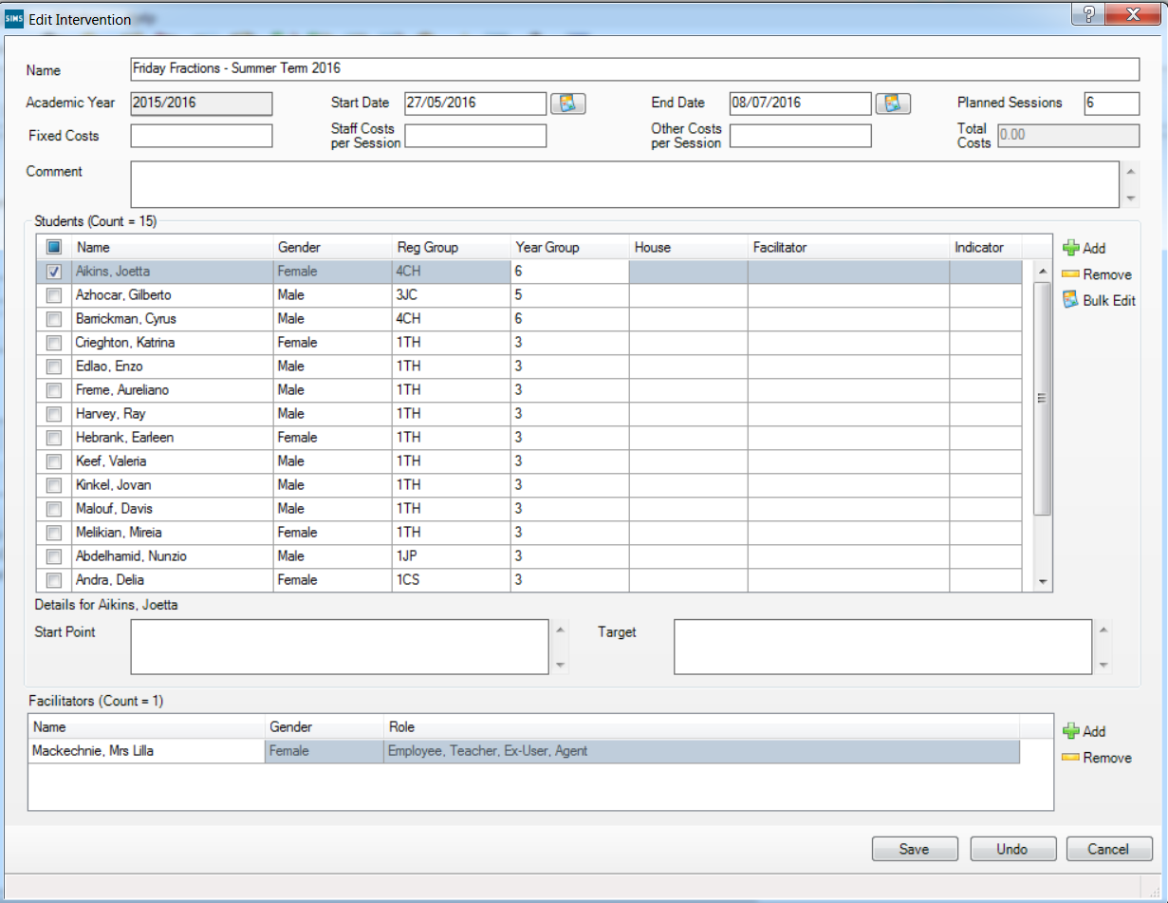
Bulk update students
Tick this box to select/deselect all the students in the grid
Click on ‘Bulk Edit’ to add in the information for the students
selected
Tick the students that you wish to add the same Start Point, Target or
Facilitator to

Slide 20
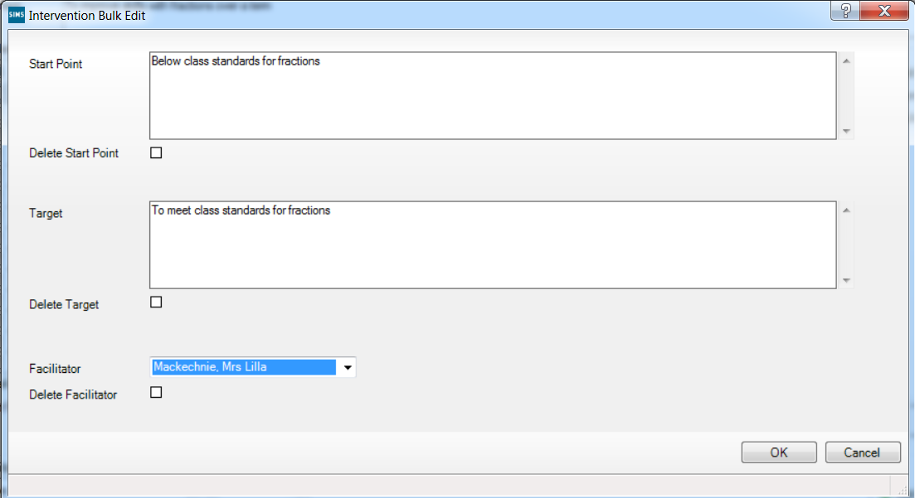
Bulk add detail to students
Add in free text in this area to update all students selected
Information added here will always overwrite any existing text
Facilitators already added to the group can be assigned to individual students

Slide 21
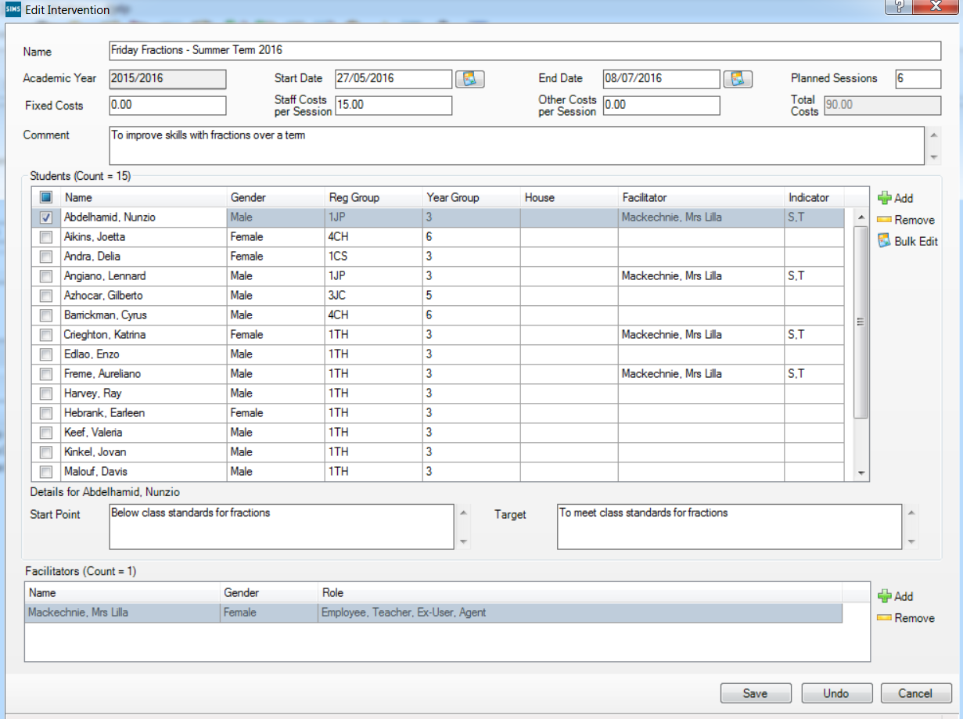
Plan Intervention Screen
Facilitators can also be assigned to students here
View ‘Start Point’ and ‘Target’ for each student when they are selected
The S and T in the indicator column, indicate that the ‘Start Point’ and ‘Target’ have been filled in for that student
Facilitators can be assigned to the group here

Slide 22
Running Interventions

Slide 23
Run Intervention
Quickly find Interventions you are associated to
Newest Interventions show
at the top
My Intervention shows just the Interventions to which the logged in user has been added as a Facilitator

Slide 24
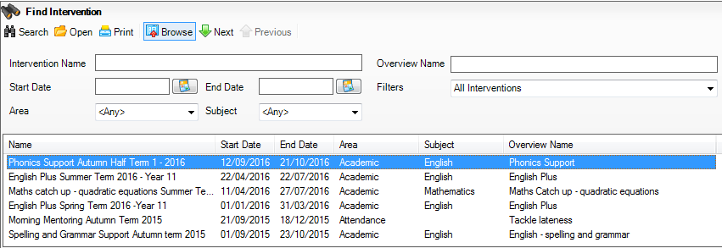
Run Intervention
Find all Interventions
‘All Interventions’ will show all Interventions ever, regardless of Facilitator

Slide 25
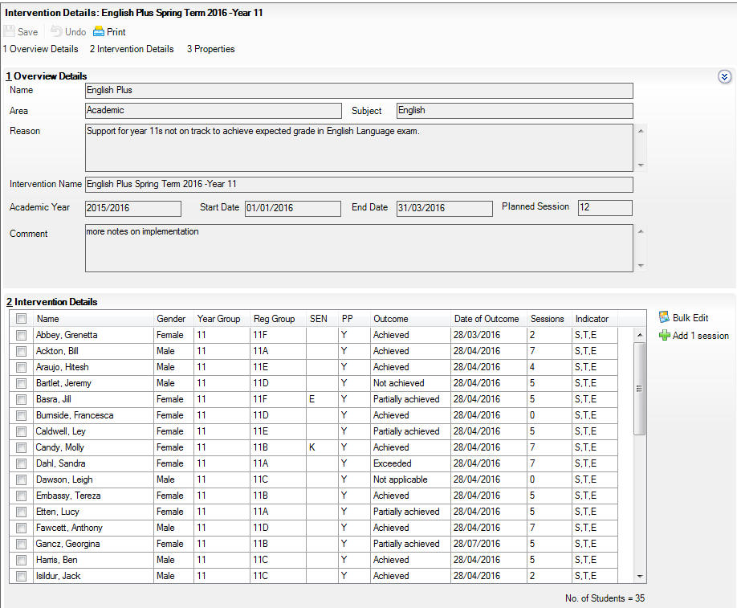
Run Intervention
View all information added in the Plan screen, to understand the context of the Intervention
To save space, this panel can be minimised

Slide 26
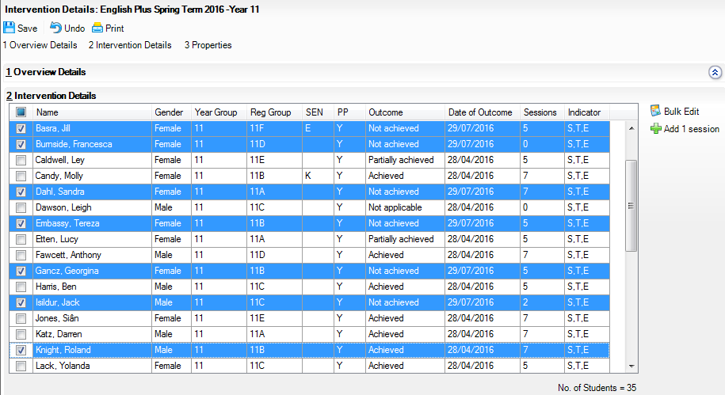
Run Intervention – record number of sessions
The number can also be changed manually for any given student, by typing in the ‘Sessions’ column
Tick to select/deselect all
Add one session to the session count for all students selected
Tick as many students as have turned up to the Intervention on any given day

Slide 27
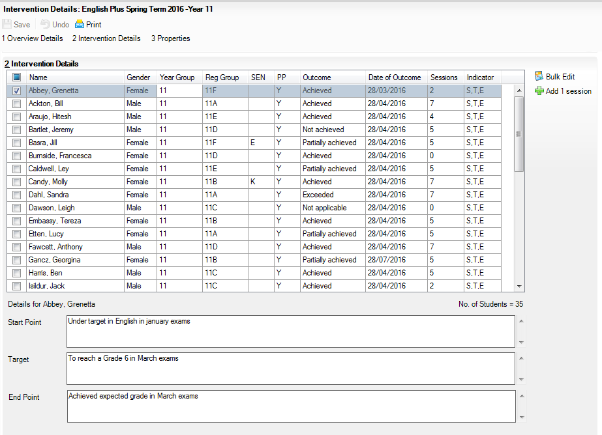
Run Intervention – add details
It is also possible to Bulk enter the ‘End Point’ via this button
In this screen, it is also possible to add in the ‘End Point’ of a student – where they got to when the Intervention ended
The ‘E’ in this column shows that the ‘End Point’ has been filled in for each student

Slide 28
Run Intervention – Add details to students: Outcome
It is possible to enter an Outcome via the Run screen.
The ‘Date of Outcome’ defaults to today’s date, but can be backdated too
The Outcome is designed to give the ability to compare different types of Interventions
These options are defaults and can be customised

Slide 29
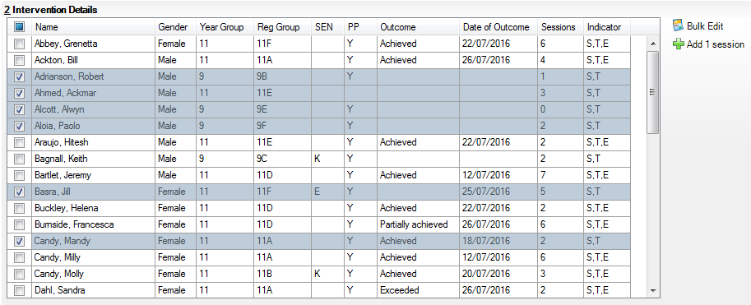
Update student details in bulk
Select/deselect all students in the grid
Click here to enter information for all students selected
Highlight multiple students

Slide 30
Update student details in bulk
Add in details for selected students
All information added will overwrite any existing information for the students selected

Slide 31
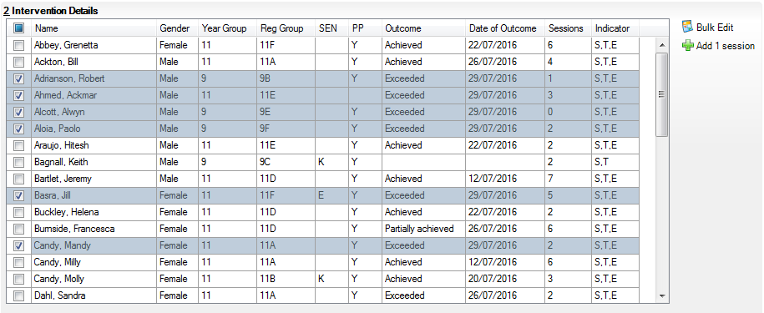
Update student details in bulk
These students now have End Points added, and the same Outcome and Date of Outcome

Slide 32
View all details for a student
Click on any student to view/edit their details below.

Slide 33
Reporting

Slide 34
Key reports
Adding Interventions as group filter in Assessment Manager
Adding Interventions to the reporting dictionary
School Intervention Report
Intervention Outcome Analysis
Interventions in SIMS Discover
Student Intervention Report
Notes:
Reports highlighted in blue will be available as part of the pilot.

Slide 35
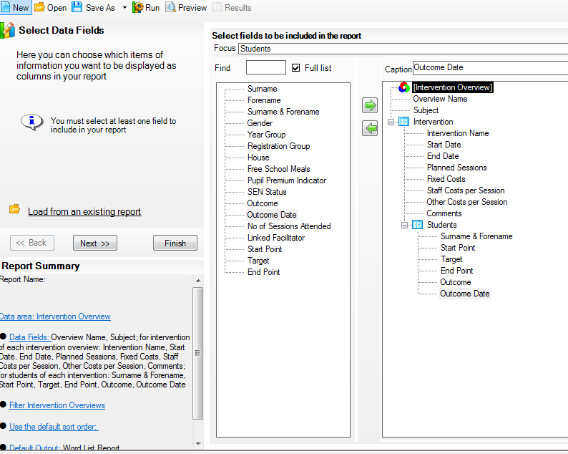
Interventions in the Reporting Dictionary
Notes:
Also available from the student, applicant, staff, contact and agent nodes

Slide 36
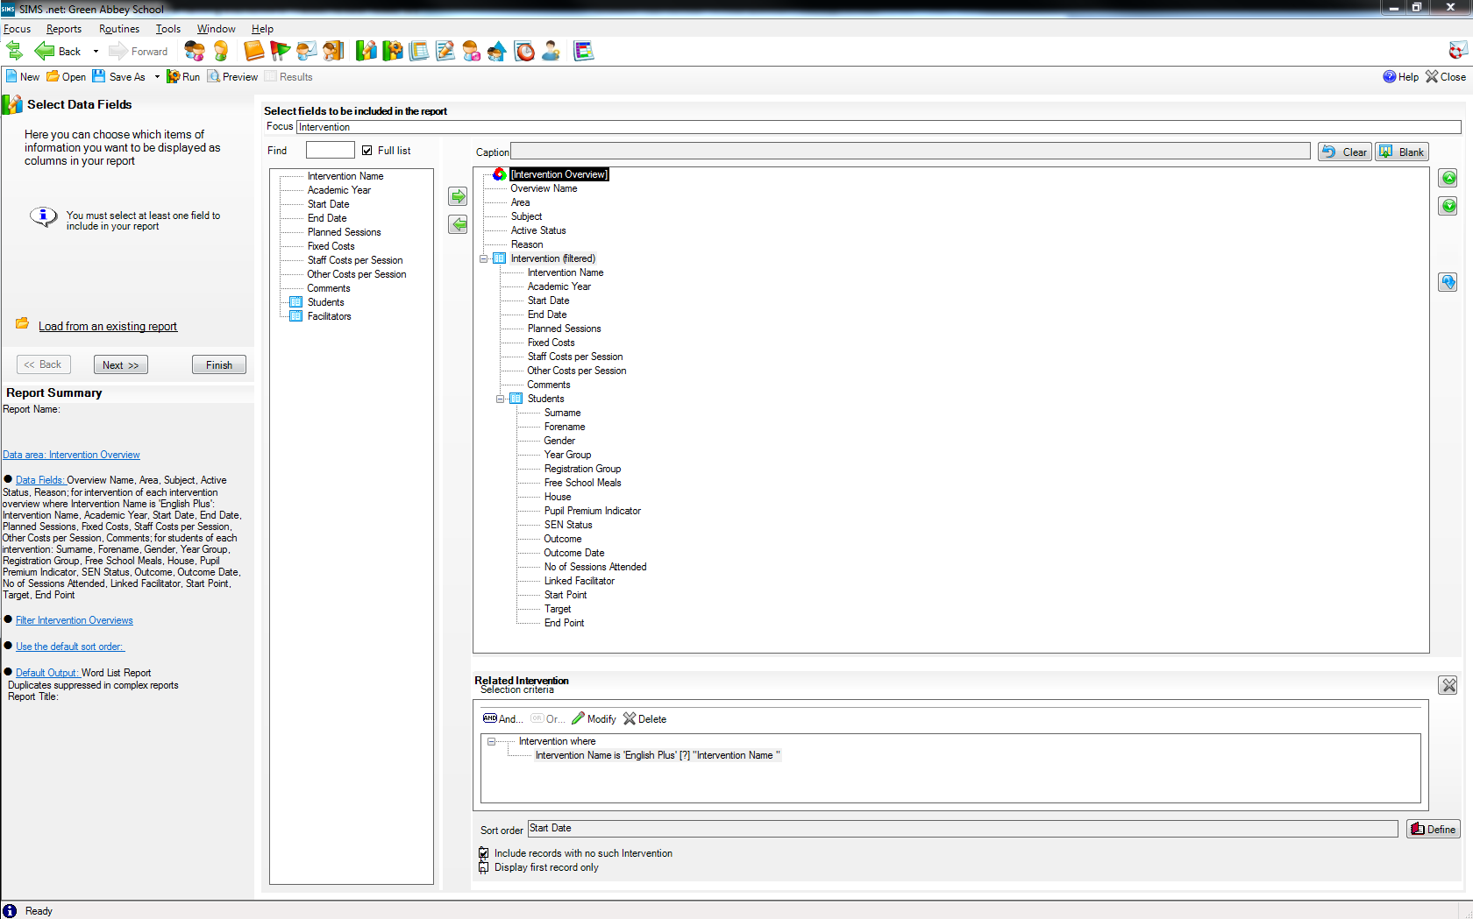
Interventions in the Reporting Dictionary

Slide 37
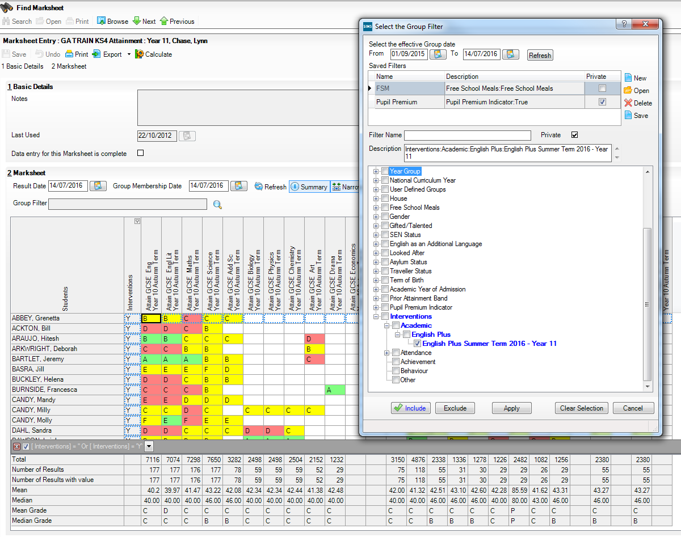
Assessment Manager Marksheets

Slide 38
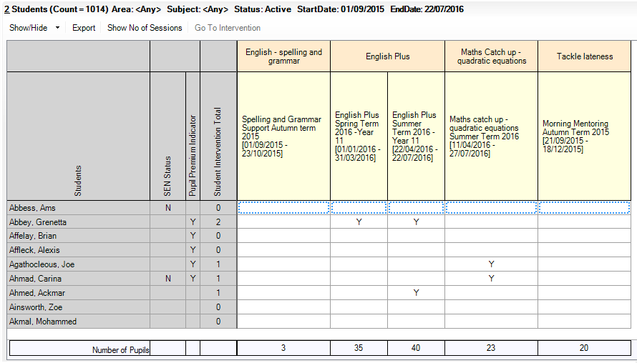
School Intervention Report
Reports | Interventions | School Intervention Report
Export straight to Excel for any further analysis you might want
Edit the Intervention you are viewing directly from this button
See the total number of sessions attended by students
Understand exactly which students are on which interventions
Use Show/Hide or right click on ‘Students’ to add extra student identifiers. These also export
See Intervention membership totals at a glance
Click on any column header to sort or filter by the within it

Slide 39
School Intervention Report
Choose different options to filter the report by, to understand the detail of what is happening in school

Slide 40
Intervention Outcome Analysis
Reports | Interventions | Intervention Outcome Analysis Report

Slide 41
Intervention Outcome Analysis
Export to Excel – exactly as the screen shows at the point of export
Edit any Intervention via this button
See the total number of students receiving each Outcome within an Intervention
See the percentage of students receiving each Outcome within an Intervention
Any students without an Outcome show here
See the total number of students receiving each Outcome across all Interventions in the date range
Expand any Intervention to see the Outcomes given to individual students within the Intervention

Slide 42
Using Discover and Interventions
Identify students using Discover
Create Discover groups
Add students from Discover group to Interventions
Filter Discover graphs of achievement over time by Interventions
Record outcome and success in Interventions module

Slide 43
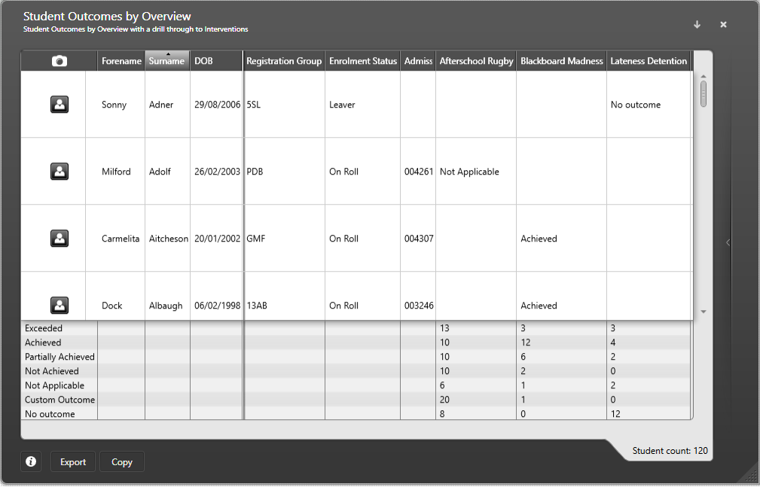
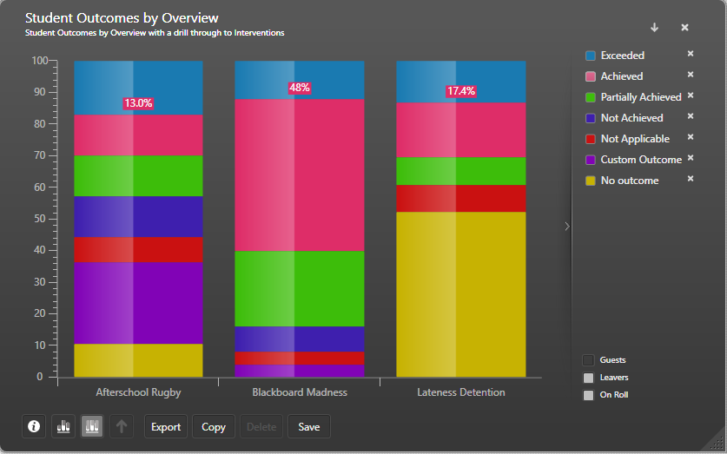
Report on Intervention Overview effectiveness in Discover
Notes:
Student outcomes by overview with drill through (shown on next slide) to Outcomes by Intervention

Slide 44
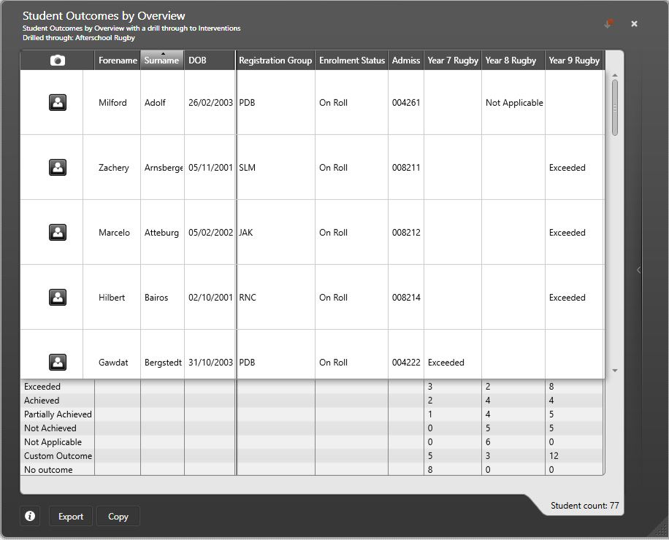
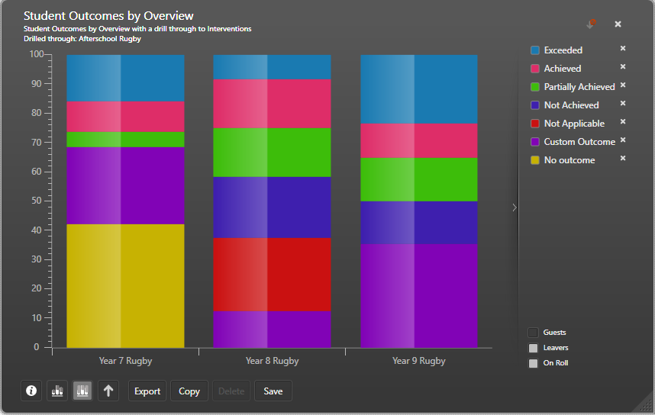
Report on Intervention Effectiveness in Discover

Slide 45
Where next?
Pilot in Autumn
Documentation and starter packs will be available on MyAccount
This will include a number of presentations and video resources on how to use the Interventions module
There will also be information on how Interventions helps schools

Slide 46
Where next?
Dependent and subject to change, based on feedback from pilot and at full release
Current ideas include:
Further links to Interventions
Take Register
Student Teacher View
Cost reporting
More details against students – e.g. dated comments
More reports for Attendance and Conduct with Interventions
Ability to allow parents to view Interventions

