Slide 1

SIMS Interventions
Tony Lockwood
Senior Product Manager
Notes:
Intro – housekeeping
You’ve all been muted to avoid background noise
Questioned can be sent via instant message. Answer short questions where possible. Leave more complex questions until the end

Slide 2
The National Attainment Gap
21% children are eligible for free school meals
They start school behind their better-off classmates and the gap widens throughout their schooling
37% of disadvantaged children achieve 5 good GCSEs v
63% of other pupils
Children from poorer backgrounds do worse on average than their wealthier classmates whichever type of school they are in
The attainment gap between rich and poor pupils is stark in the UK v other OECD countries.
Young people with poor educational attainment are much more likely to end up not in education, employment or training (NEET)
(Education Endowment Fund 2016)
Notes:
The Education Endowment Fund is an organisation dedicated closing the attainment gap to ensure that children and young people from all backgrounds can fulfil their potential and make the most of their talents. They have funded research into what are the most cost-effective interventions

Slide 3
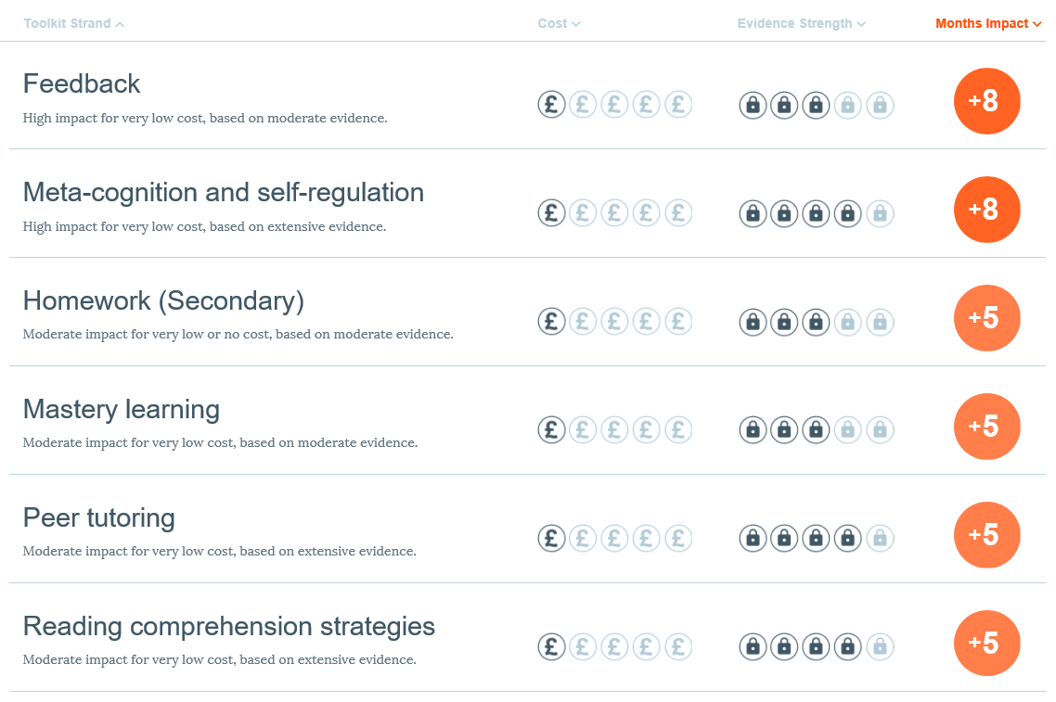
Education Endowment Fund Teaching & Learning Toolkit
Notes:
This slide shows the top 6 most cost-effective Interventions used in schools

Slide 4
DfE and OFSTED Pupil Premium
Schools must publish a strategy for the school’s use of the pupil premium
your school’s pupil premium grant allocation amount
a summary of the main barriers to educational achievement faced by eligible pupils at the school
how you’ll spend the pupil premium to address those barriers and the reasons for that approach
how you’ll measure the impact of the pupil premium
the date of the next review of the school’s pupil premium strategy
The current OSFTED handbook refers to PP rationale and impact i.e. when schools post their PP plan and review of funding they need to have a robust rationale regarding what they have done and what they intend to do in future. They should also have evidence of the impact that the funding has had on PP pupil outcomes. Interventions data will provide the evidence
Notes:
Interventions can also be used be to improve attendance, behaviour or general wellbeing as well as grades

Slide 5
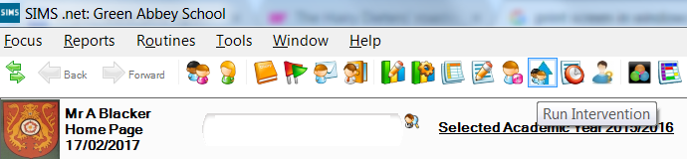
What is SIMS Interventions?
New module
Integrated in SIMS7 Core
Part of annual entitlement
Pilot from Autumn 2016
General Availability from Spring 2017
Use Interventions to demonstrate impact and cost
Notes:
Will be included in ISMS primary later in 2017

Slide 6
How does Interventions work?
Identify under performing students
Set up Intervention Allocate support and resources
Run Intervention
Review outcomes and costs
Improve student outcomes
Notes:
SIMS Interventions will be a system to track underperforming students, allocate additional support and resources, and track how those resources affect KPIs, as well as how much those resources cost, from a central area, so that outcomes can be tracked against cost.

Slide 7
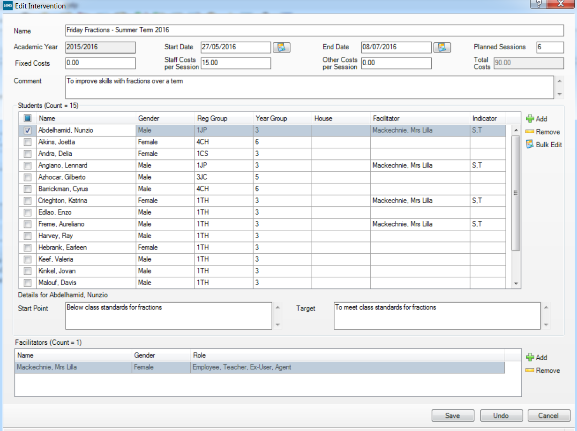
Planning interventions
Define your intervention
Add students and facilitators
Add targets
Notes:
Interventions can be grouped together, can be used many times, costs can be recorded
It is easy to locate students from key groups such as pupil premium, FSM, SEN, G&T etc.
Student targets etc. can be updated in bulk

Slide 8
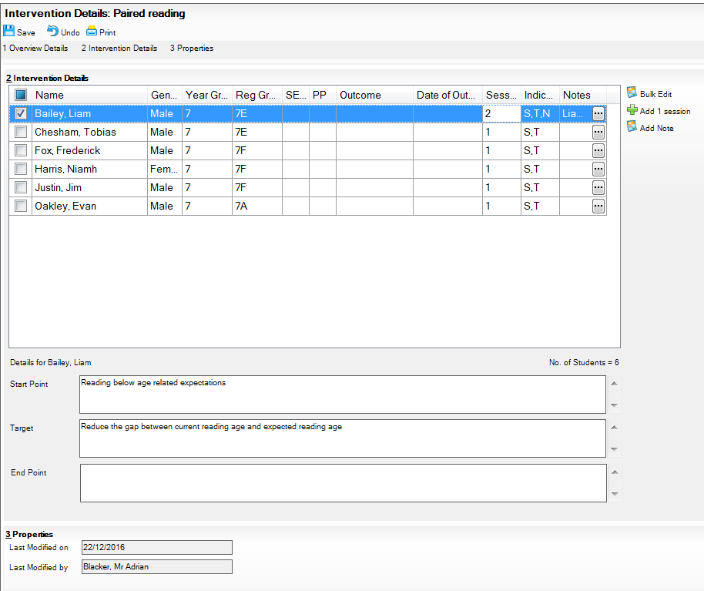
Running interventions
Track progress
Add information
Enter outcomes
Add notes
Notes:
You can quickly find the Interventions you are associated with and easily add information and outcomes, this can be done in bulk

Slide 9
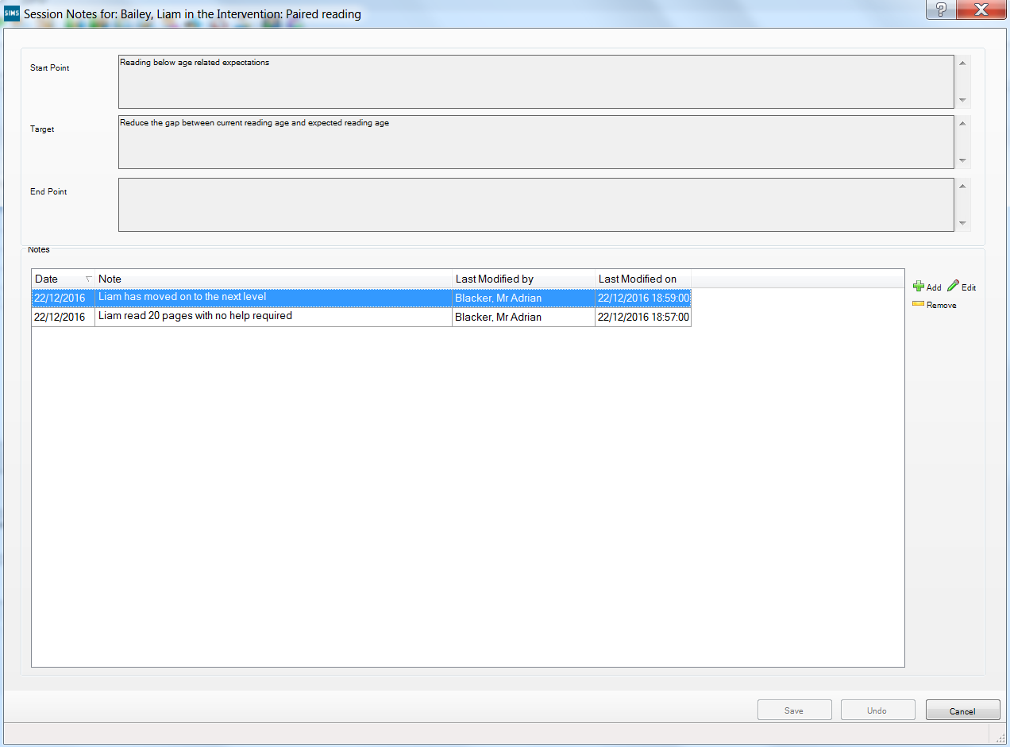
Adding notes
Add notes
Notes:
You can quickly find the Interventions you are associated with and easily add information and outcomes, this can be done in bulk

Slide 10
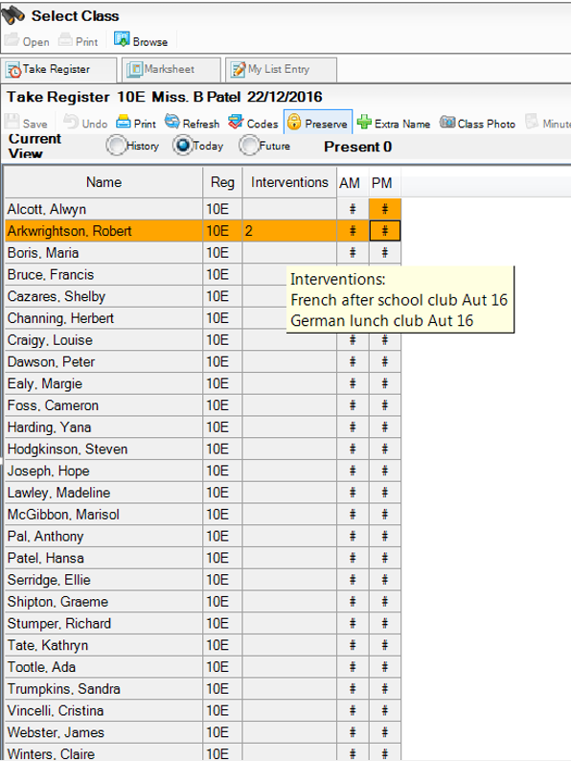
Interventions in Registers
Hover for details

Slide 11
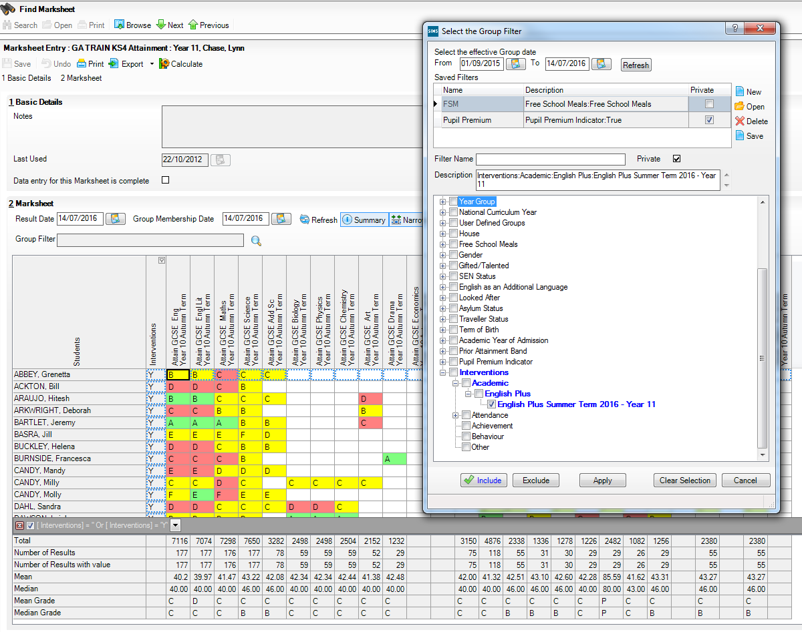
Interventions in Assessment Manager

Slide 12
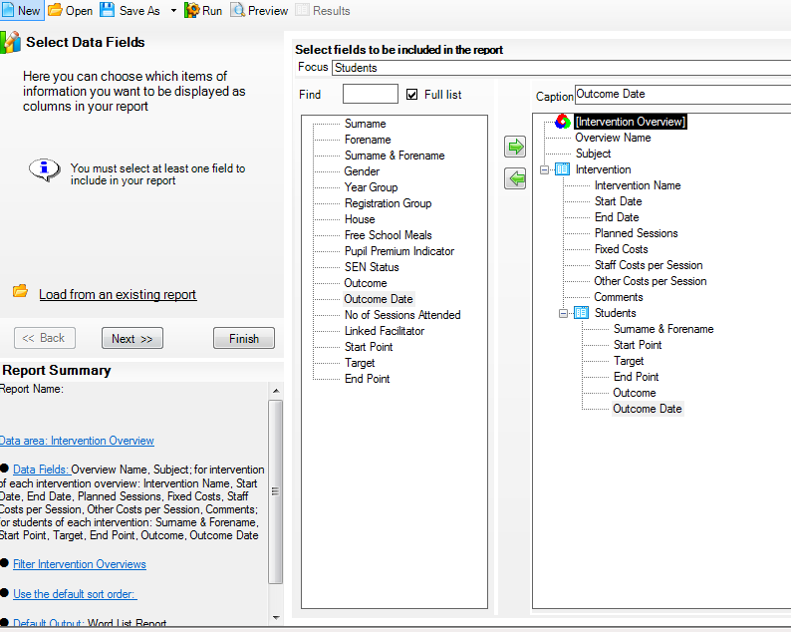
Interventions in the reporting dictionary

Slide 13
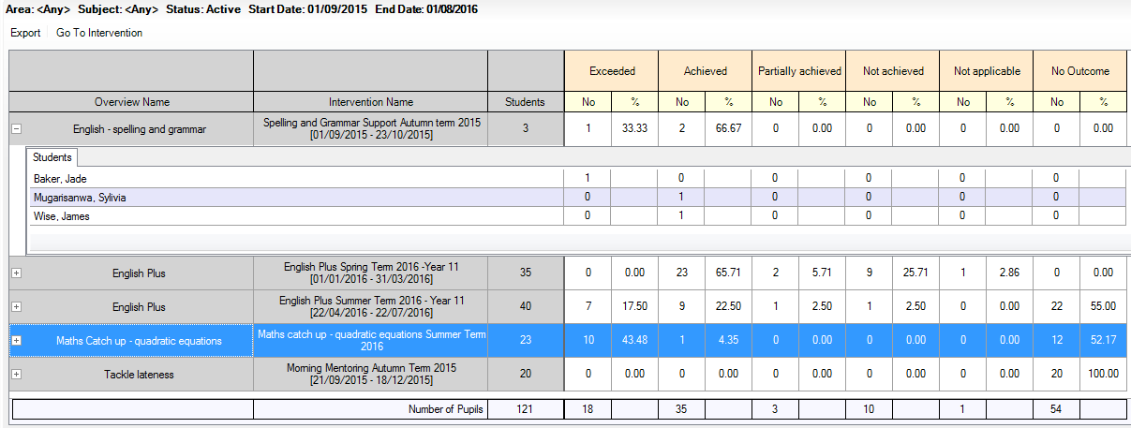
Interventions outcome analysis
Export to Excel – exactly as the screen shows at the point of export
Edit any intervention via this button
See the total number of students receiving each outcome within an intervention
See the percentage of students receiving each outcome within an intervention
Any students without an outcome show here
Expand any intervention to see the outcomes given to individual students within the intervention
See the total number of students receiving each outcome across all interventions in the date range
Notes:
Is it working?

Slide 14
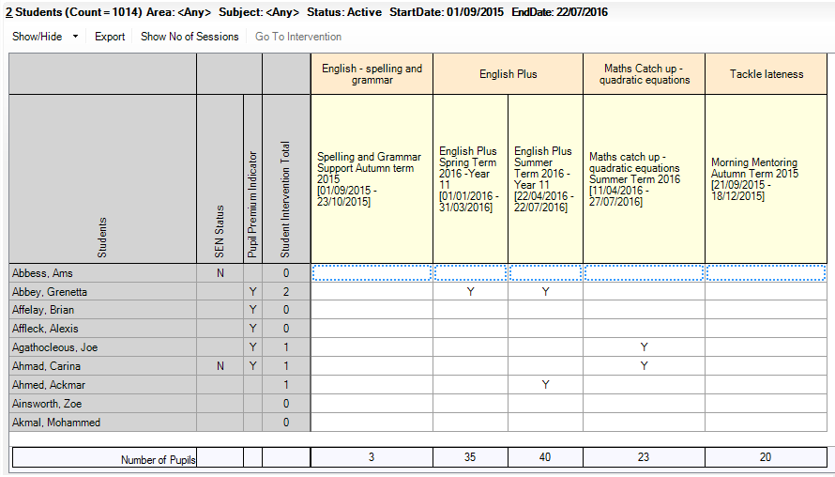
School interventions report
Click on any column header to sort or filter by the within it
Export straight to Excel for any further analysis you might want
Edit the intervention you are viewing directly from this button
See the total number of sessions attended by students
See intervention membership totals at a glance
Use show/hide or right click on ‘Students’ to add extra student identifiers. These also export
Understand exactly which students are on which interventions
Notes:
What’s going on
Identifies student in many interventions
Overview of whole school, export to Excel

Slide 15
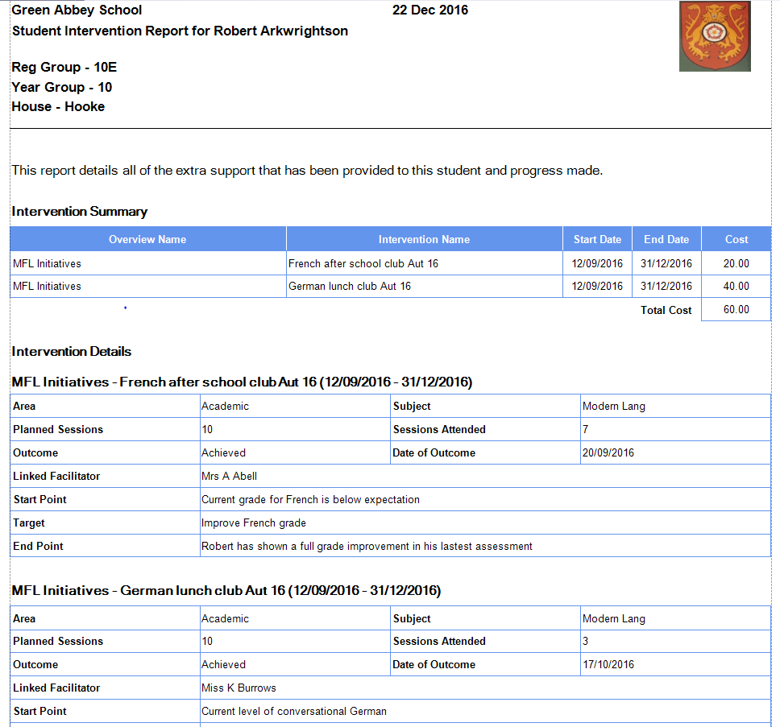
Student interventions report
See the details of all Interventions for each student
Notes:
Is it working?

Slide 16
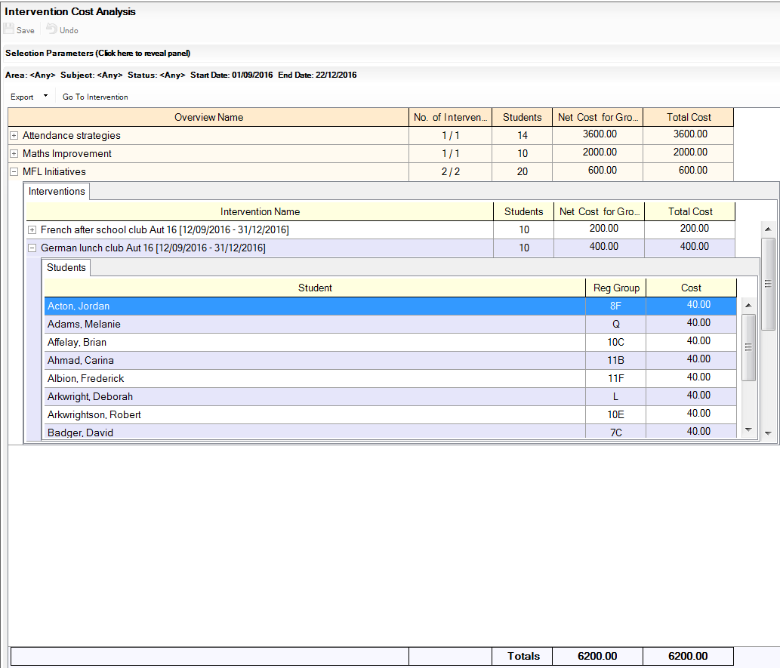
Interventions cost analysis reports
See the total cost of all Interventions, Intervention Overviews, Interventions and individual students
Notes:
Is it working?

Slide 17
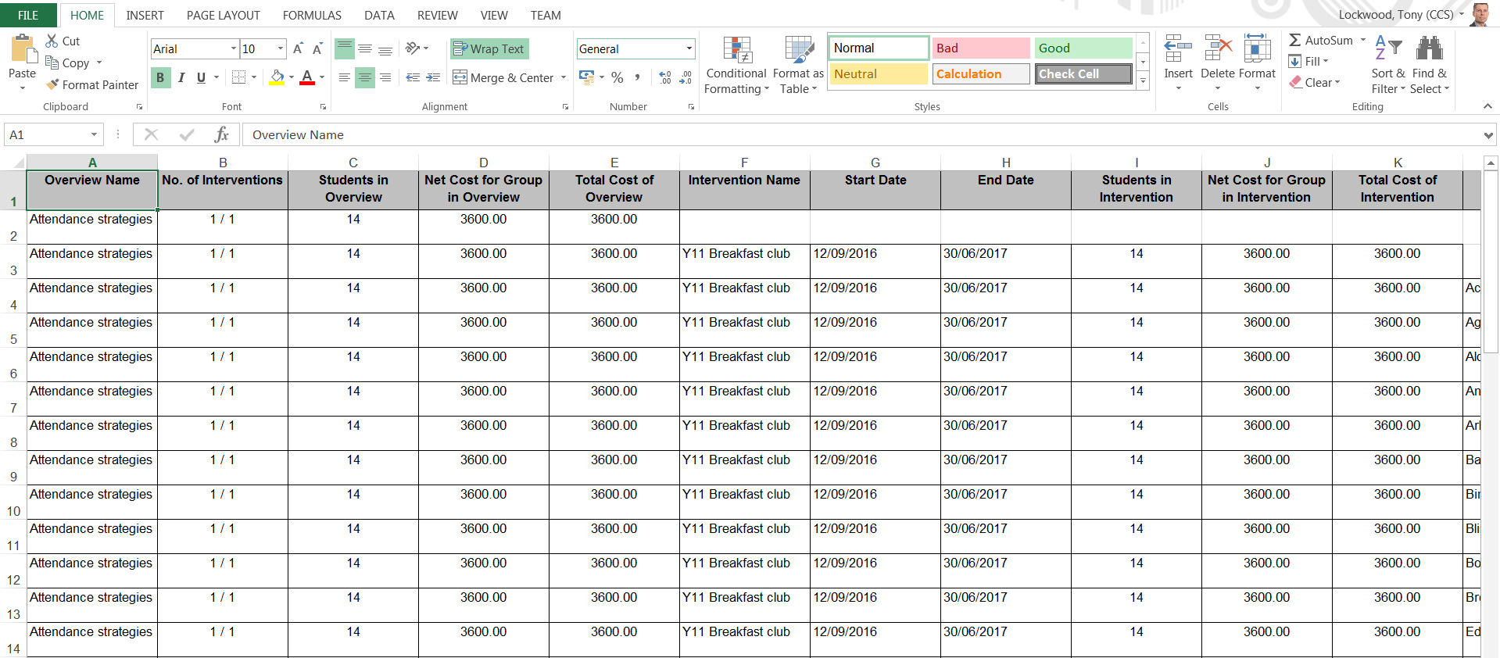
Interventions cost analysis reports
Export unformatted to create you own view of the costs
Notes:
Is it working?

Slide 18
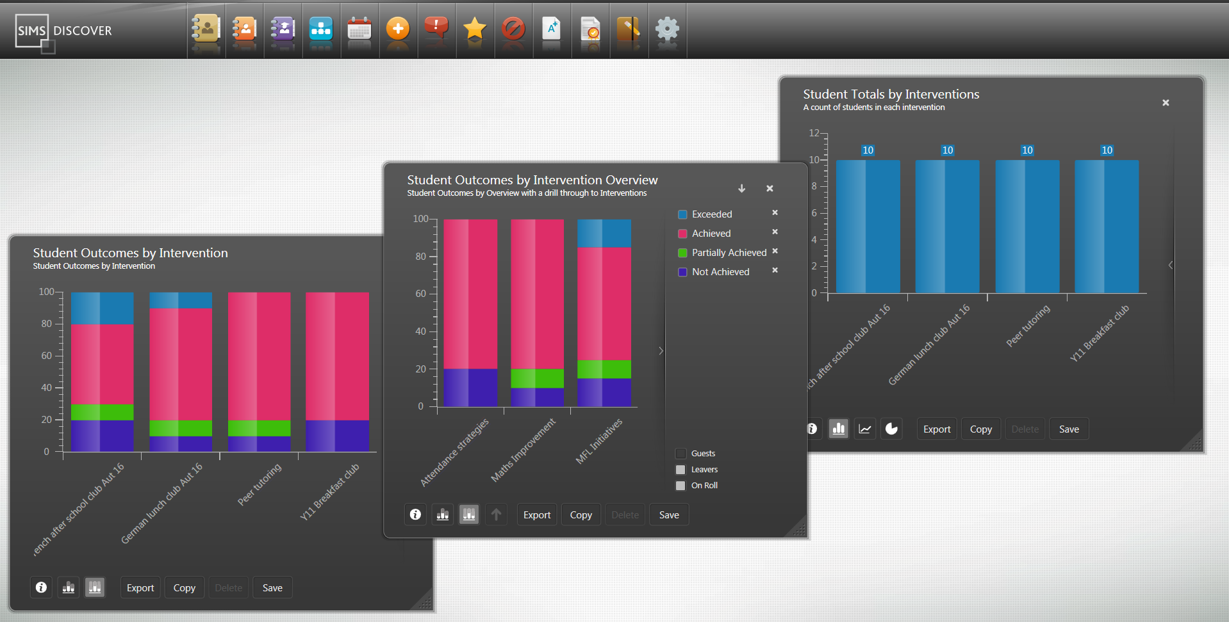
Interventions in SIMS Discover

Slide 19
Next steps for viewers
Interventions blog
http://www.capita-sims.co.uk/resources/blog/are-you-tracking-your-interventions-effectively
Did you know videos
http://www.capita-sims.co.uk/resources/list?type=video&topic=All&school_type=All
Resources
https://myaccount.capita-cs.co.uk/hot-topics/SIMSInterventions/

Slide 20


