Slide 1

Interventions
Capita SIMS

Slide 2




What are Interventions?
Interventions are anything that a school is running for students or pupils that help them in part of their school life, additionally to what they would do for any other pupil.
This could be for:
Attendance
Academic
Behavioural
Pastoral
Notes:
Attendance interventions → e.g. interventions on lateness in the morning such as breakfast club, or on overall attendance, such as regular meetings with a key member of staff to check up/discuss their attendance
Academic interventions → e.g. phonics support (more primary, but could be lower end of KS3 too), or year 11 catch up sessions to help meet GCSE targets in English or maths
Behavioural/Achievement/conduct interventions → e.g. time in inclusion unit, use of report cards, regular meetings with parents
Pastoral interventions → e.g. mentoring, peer buddy system.
Not all interventions necessarily have to be timetabled, and many will target lots of different students, and be measured against lots of different things.

Slide 3



How do Interventions relate to SIMS?
Brand new module
Integrated into SIMS7 Core
Due in Spring 2017

Slide 4

What will the new Interventions Module do?
SIMS Interventions will be a system to track underperforming students, allocate additional support and resources, and track how those resources affect KPIs, as well as how much those resources cost, from a central area, so that outcomes can be tracked against cost.

Slide 5
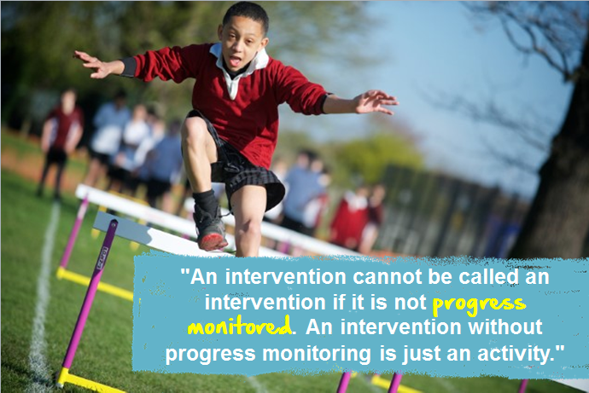
Notes:
We’ve focussed our efforts on including the most useful reporting that we possibly can, in order to help schools understand exactly which Interventions are working, and which are not.

Slide 6



What does SIMS Interventions do?
Plan Intervention
Run Intervention
Reporting
Notes:
Three key areas:
Plan allows you to set interventions up – will normally be accessed by deputy heads, SENCOs, etc. who have the rights to make a decision about what interventions students should have
Run allows you to add details to students – will normally be accessed by teachers and teaching assistants (and data might be entered from here on behalf of an outside agent too)
Reporting allows you to understand more about interventions happening in your school – can be accessed by anyone, but is especially important for anyone making a decision

Slide 7
Key parts of SIMS Interventions
Reporting
Intervention definitions
Student memberships
Student details
Notes:
SIMS interventions is divided up into three layers of data –
What the intervention is and what it’s about
Which students/pupils are on the intervention and at what time?
Extra detail about students
PLUS – & most importantly - the ability to report on all of these things in context of all the other SIMS data available

Slide 8

PLAN INTERVENTION

Slide 9
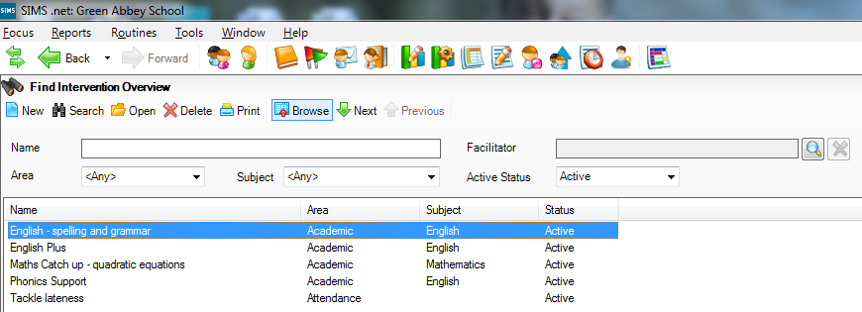
Plan Intervention
Create new Interventions
Find existing Interventions
Find Interventions related to a particular subject
Find Interventions associated to any adult in the system
View key information about existing Interventions

Slide 10
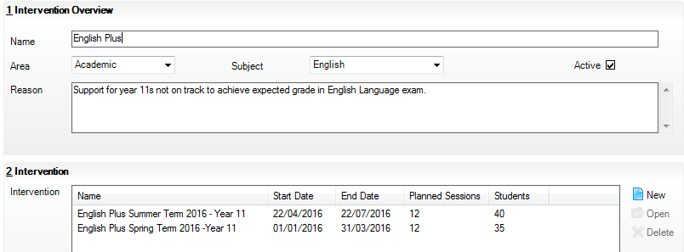
Plan Intervention
Enter this information once – use as many times as you want
Help find the right Interventions for the right analysis later on
Help HoDs find Interventions related to their department
Customise your Intervention names
Group multiple interventions of the same type together – easier to find later
Add in the dates of Interventions and when they are running
Notes:
Grouping the Interventions that are similar together in this way will make it easier to find interventions that are similar, but will also help later on when you want to analyse them, as they will also be grouped in the analysis, as well as being able to report at intervention overview level, with all of them together.

Slide 11
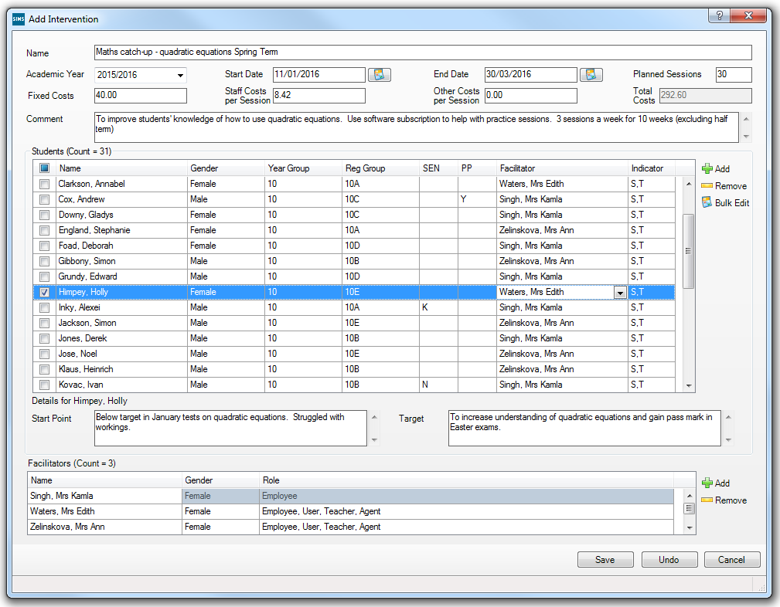
Plan Intervention
Include the number of sessions you are planning on running – if any
See at a glance the total costs for this Intervention
Define exactly when the Intervention is running
Useful filters will help you find students to add in quickly
Bulk enter Start Point, Target and Facilitators for multiple students
View and edit the Start Point and Targets for any student
Add in any adult recorded in SIMS – teachers, employees, contacts and agents
Notes:
You can assign as many adults as you want to an intervention. This will help those people find the interventions that they are associated to when they’re running the intervention. It also will help when you want to analyse interventions later on. For example, if you have two interventions that are the same being run by different people and one is going much better than the other, then you could get each teach to share best practice to help improve the effectiveness of the intervention overall. Assigning adults to individual students can also help with safeguarding, giving you a record of which adults have interacted with any given student.

Slide 12

RUN INTERVENTIONS

Slide 13
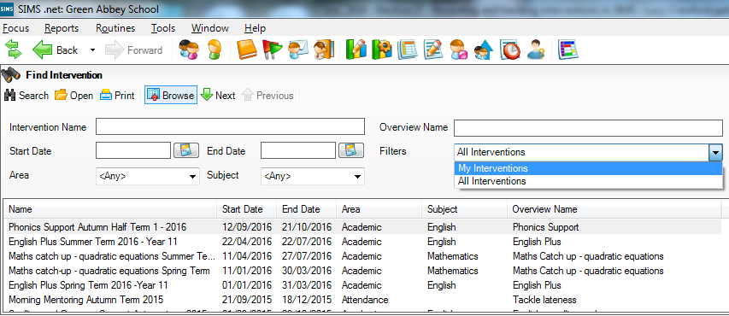
Run Intervention
Automatically see the Interventions that you are associated to
Choose to see all Interventions in the system
See the newest Interventions at the top to find the right one quickly
Easily see what subject the Interventions relate to, or filter by subject

Slide 14
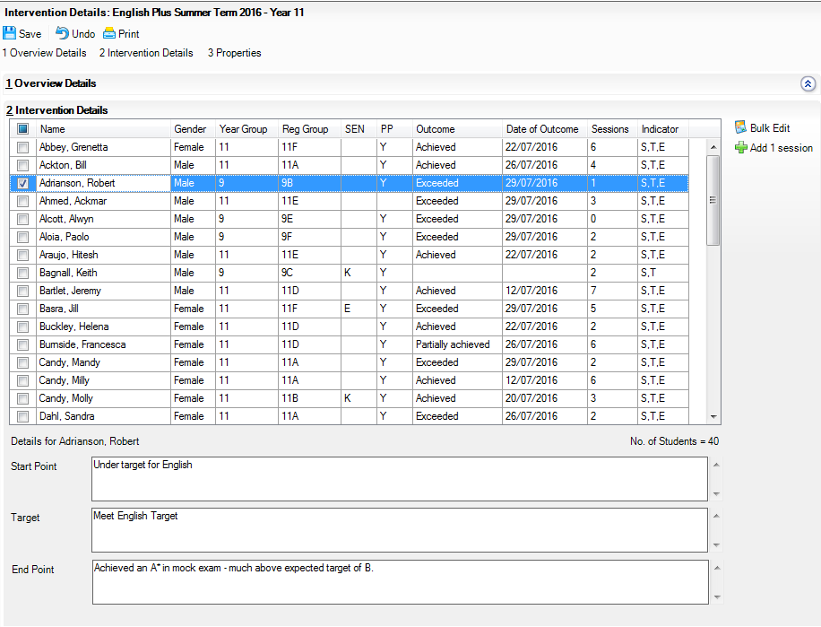
Run Intervention
Outcome gives you the ability to compare Interventions across different measures
Bulk update End Point and Outcome for students
Easily add in a new session to the ‘Sessions’ count, by ticking the students who have attended, and clicking here
View and update Start Point, Target and End Point for individual students
Notes:
Outcome predefined options are: Exceeded, Achieved, Partially Achieved, Not Achieved, Not Applicable
Date of Outcome defaults to today.

Slide 15

REPORTING ON INTERVENTIONS

Slide 16
Key reports
Adding Interventions as group filter in Assessment Manager
Adding Interventions to the reporting dictionary
School Intervention Report
Intervention Outcome Analysis
Interventions in SIMS Discover
Student Intervention Report

Slide 17
Interventions in Assessment Manager
Filter any assessment manager screen by Interventions:
  Marksheets
  Programme of Study Entry
  Progress Grids
  Tracking Grids
Use this filtering to compare the results of students with and without different Interventions
View whether or not students have been on one or more Interventions with an Interventions column – quick view

Slide 18
Interventions in Reporting Dictionary
Design your own reports
Complete flexibility to report on any Interventions fields
Mail merge information about Interventions to send reports to parents
Report against any other key data held in SIMS such as Behaviour, Achievement and Attendance

Slide 19
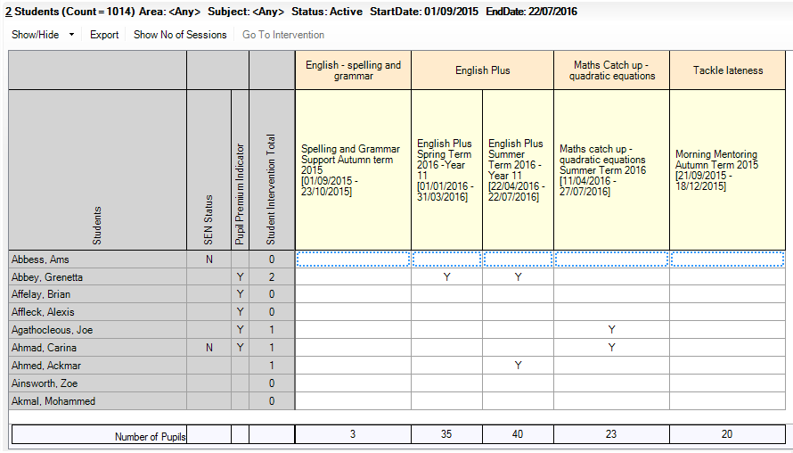
School Intervention Report
Export straight to Excel for any further analysis you might want
Edit the Intervention you are viewing directly from this button
See the total number of sessions attended by students
Use Show/Hide or right click on ‘Students’ to add extra student identifiers. These also export
See Intervention membership totals at a glance
Click on any column header to sort or filter by the within it
Notes:
It is also easy to filter by:
date,
subject,
area (academic, behaviour, achievement, attendance and other)
Student membership – e.g. just look at your students with pupil premium, or just look at your students with

Slide 20
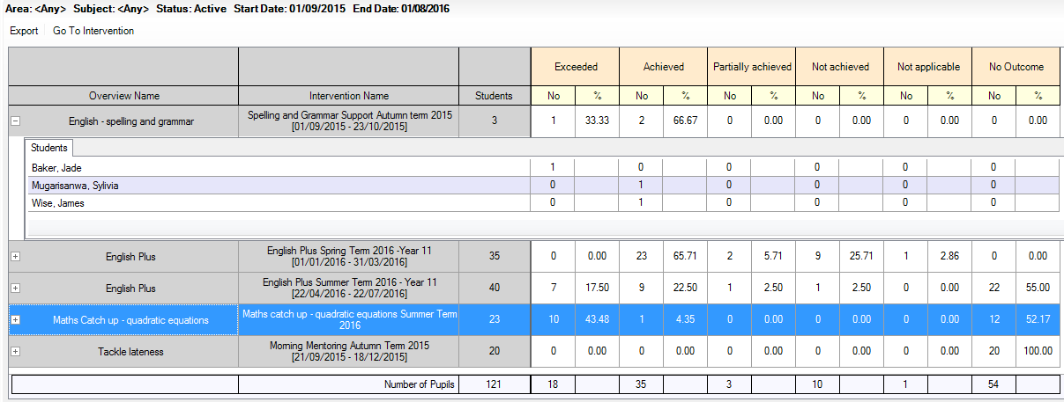
Intervention Outcome Analysis
Export to Excel – exactly as the screen shows at the point of export
Edit any Intervention via this button
See the total number of students receiving each Outcome within an Intervention
See the percentage of students receiving each Outcome within an Intervention
Any students without an Outcome show here
Expand any Intervention to see the Outcomes given to individual students within the Intervention
See the total number of students receiving each Outcome across all Interventions in the date range
Notes:
Use this report to understand exactly which Interventions are working best for your students in your school.
This can also be filtered by the same items that the School Intervention Report can be, such as pupils with certain attributes, by subject, by area, etc.

Slide 21




0800 170 1734
info@capita-sims.co.uk
www.capita-sims.co.uk
Follow us on Twitter @CapitaSIMS

