Slide 1

FSM Eligibility changes for Academic Year 2026/27 onwards
Jim Haywood (he/him)
Statutory Returns Specialist
Version 1.0
jim.haywood@sims-mis.com

Slide 2
FSM Eligibility changes for Academic Year 2026/27
DfE CBDS
CBDS fields
  Academic Year 2025/26
    FSM Eligibility Start Date
    FSM Eligibility End Date
    FSM Eligibility UK Country

Slide 3
FSM Eligibility changes for Academic Year 2026/27
DfE CBDS
CBDS fields
  Academic Year 2025/26
    FSM Eligibility Start Date
    FSM Eligibility End Date
    FSM Eligibility UK Country
  Academic Year 2026/27 onwards
    FSM Eligibility Start Date
    FSM Eligibility End Date
    FSM Eligibility UK Country

Slide 4
FSM Eligibility changes for Academic Year 2026/27
DfE CBDS
CBDS fields
  Academic Year 2025/26
    FSM Eligibility Start Date
    FSM Eligibility End Date
    FSM Eligibility UK Country
  Academic Year 2026/27 onwards
    FSM Eligibility Start Date
    FSM Eligibility End Date
    FSM Eligibility UK Country
    FSM Eligibility Last Verified Date
    FSM Eligibility Category

Slide 5
FSM Eligibility changes for Academic Year 2026/27
DfE CBDS
CBDS lookup codes for FSM Eligibility Category
  Academic Year 2025/26
    Although FSM Eligibility Category did not exist for Academic Year 2025/26, for many statistical purposes it can be thought of as having FSM Category of TFSM (see below). This is not literally true as FSM Eligibility is protected up to the end of Academic Year 2025/26.

Slide 6
FSM Eligibility changes for Academic Year 2026/27
DfE CBDS
CBDS lookup codes for FSM Eligibility Category
  Academic Year 2025/26
    Although FSM Eligibility Category did not exist for Academic Year 2025/26, for many statistical purposes it can be thought of as having FSM Category of TFSM (see below). This is not literally true as FSM Eligibility is protected up to the end of Academic Year 2025/26.
  Academic Year 2026/27 onwards - only one of the following can apply for any given period
    TFSM (Targeted FSM Eligibility): Universal Credit with income of £7400 or less.
    EFSM (Expanded FSM Eligibility): Universal Credit with income above £7400.
    OFSM (Other FSM Eligibility): Any other FSM Eligibility that the school wishes to use it for. It should not be used for any period where TFSM or EFSM are available.

Slide 7
FSM Eligibility changes for Academic Year 2026/27
DfE CBDS
CBDS lookup codes for FSM Eligibility Category
  DfE wording
    Targeted FSM
      Records if the pupil is in the original cohort of pupils eligible for FSM. That is, those pupils with a household income of less than £7.4k. This threshold will continue to be used to measure FSM6 (used for accountability, Pupil Premium and National Funding Formula deprivation funding) and Home to School Transport (HTST).
      In addition to those pupils with a household income of less than £7.4k, pupils eligible for FSM under the no recourse to public funds (NRPF) criteria, pupils whose parents/carers are receipt of pension credit; and pupils eligible due to immigration status, should also be included.

Slide 8
FSM Eligibility changes for Academic Year 2026/27
DfE CBDS
CBDS lookup codes for FSM Eligibility Category
  DfE wording
    Targeted FSM
      Records if the pupil is in the original cohort of pupils eligible for FSM. That is, those pupils with a household income of less than £7.4k. This threshold will continue to be used to measure FSM6 (used for accountability, Pupil Premium and National Funding Formula deprivation funding) and Home to School Transport (HTST).
      In addition to those pupils with a household income of less than £7.4k, pupils eligible for FSM under the no recourse to public funds (NRPF) criteria, pupils whose parents/carers are receipt of pension credit; and pupils eligible due to immigration status, should also be included.
    Expanded FSM
      Records if the pupil is in the expanded cohort of pupils eligible for FSM. That is, those pupils whose parents/carers are in receipt of UC but with a household income above £7.4K. This cohort of pupils will be eligible for meals only, and so will not attract the disadvantage funding or home to school transport as listed above.

Slide 9
FSM Eligibility changes for Academic Year 2026/27
DfE CBDS
CBDS lookup codes for FSM Eligibility Category
  DfE wording
    Targeted FSM
      Records if the pupil is in the original cohort of pupils eligible for FSM. That is, those pupils with a household income of less than £7.4k. This threshold will continue to be used to measure FSM6 (used for accountability, Pupil Premium and National Funding Formula deprivation funding) and Home to School Transport (HTST).
      In addition to those pupils with a household income of less than £7.4k, pupils eligible for FSM under the no recourse to public funds (NRPF) criteria, pupils whose parents/carers are receipt of pension credit; and pupils eligible due to immigration status, should also be included.
    Expanded FSM
      Records if the pupil is in the expanded cohort of pupils eligible for FSM. That is, those pupils whose parents/carers are in receipt of UC but with a household income above £7.4K. This cohort of pupils will be eligible for meals only, and so will not attract the disadvantage funding or home to school transport as listed above.
    Other FSM
      [for MI systems only - not collected in census] – this code covers additional types of FSM that schools might want to report on locally, for example, a pupil that a school chooses to provide free meals for, but who does not meet the Departmental eligibility criteria. Pupils recorded with this code will not attract FSM funding from the department.

Slide 10
FSM Eligibility changes for Academic Year 2026/27
SNG and SIMS 7
The following slides feature screen shots for SIMS 7 after the application of the SIMS 7 Summer Release 2026, but SNG is taking the same approach..

Slide 11
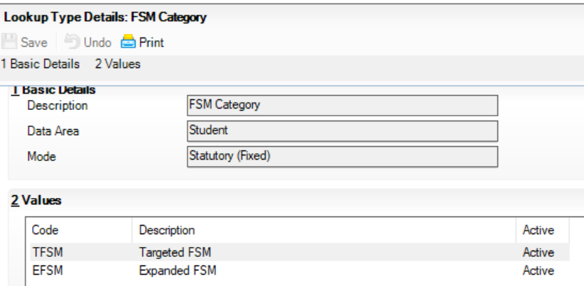
FSM Eligibility changes for Academic Year 2026/27
SIMS 7 Lookups
FSM Eligibility Category added as ‘statutory fixed’ lookup table
FSM Category of Student area of Tools | Lookups
Late change adds OFSM (Other FSM)

Slide 12
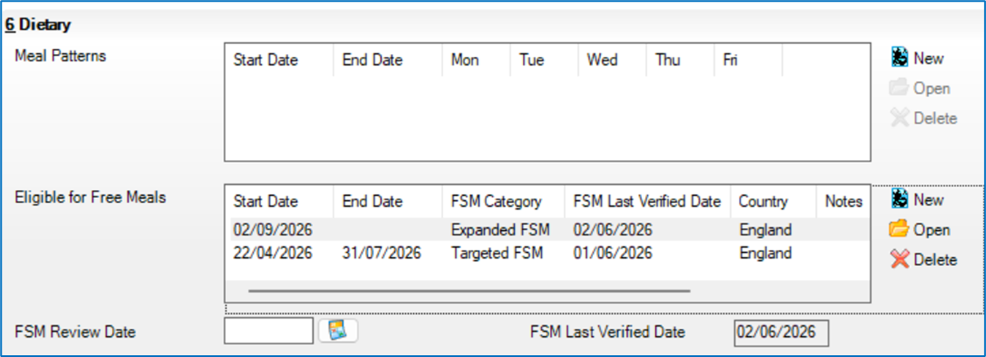
FSM Eligibility changes for Academic Year 2026/27
SIMS 7 Data Entry
The application will continue to prevent overlapping FSM eligibility records
Dietary panel of Focus | Pupil | Pupil Details

Slide 13
FSM Eligibility changes for Academic Year 2026/27
SIMS 7 Data Entry
The Dietary panel will display the last verified date for the most recent FSM eligibility record
Dietary panel of Focus | Pupil | Pupil Details

Slide 14
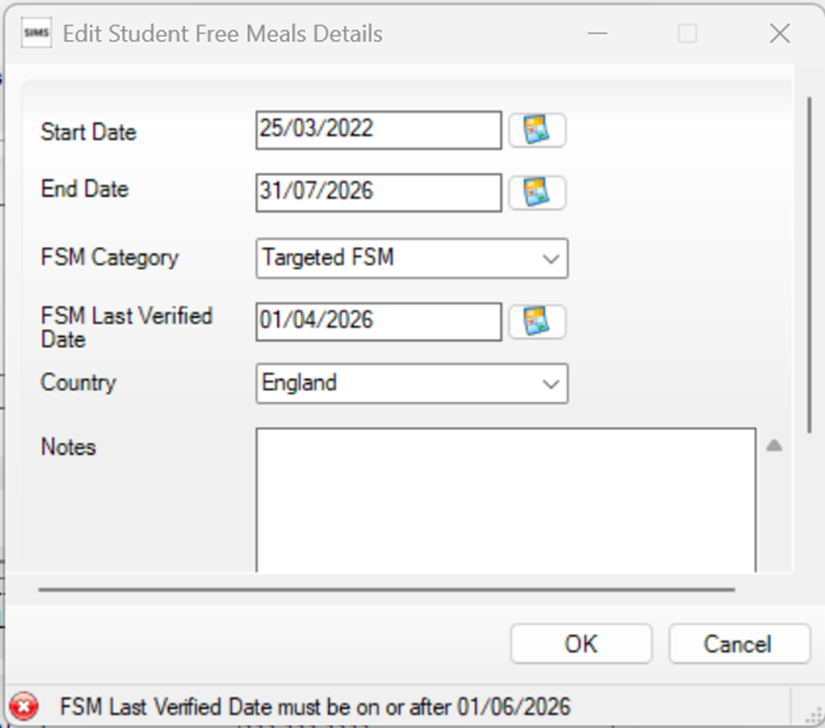
FSM Eligibility changes for Academic Year 2026/27
SIMS 7 Data Entry
FSM Eligibility last verified date must be on or after 01/06/2026
Dietary panel of Focus | Pupil | Pupil Details

Slide 15
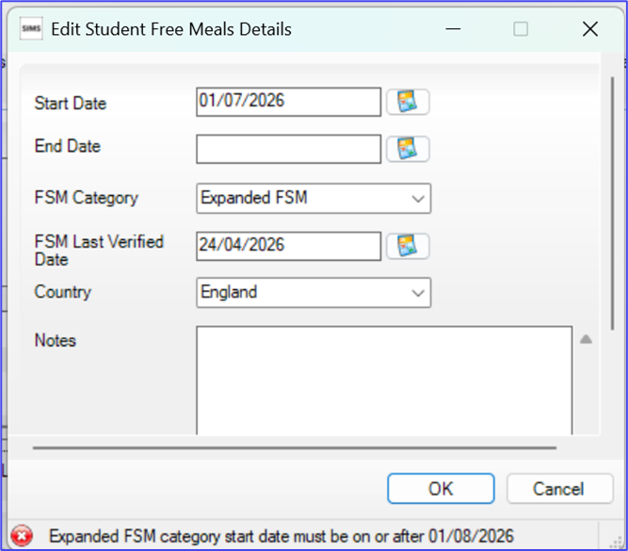
FSM Eligibility changes for Academic Year 2026/27
SIMS 7 Data Entry
Records with an FSM Category of ‘Expanded’ cannot start before 01/08/2026
Dietary panel of Focus | Pupil | Pupil Details

Slide 16
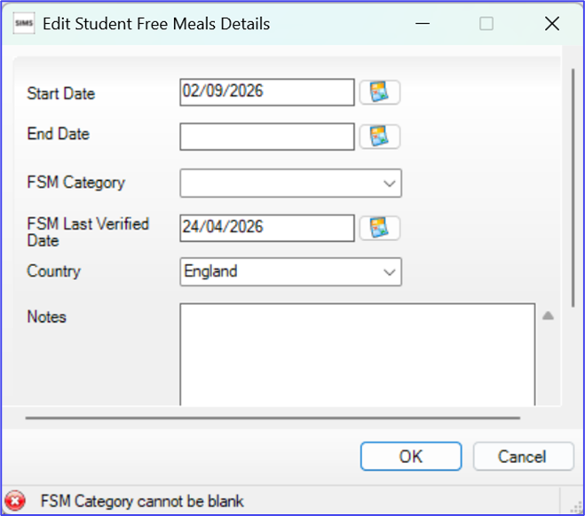
FSM Eligibility changes for Academic Year 2026/27
SIMS 7 Data Entry
Records for England with a start date on or after 01/08/2026 must have an FSM eligibility Category
Dietary panel of Focus | Pupil | Pupil Details

Slide 17
FSM Eligibility changes for Academic Year 2026/27
SIMS 7 Data Entry
Records for England with a start date on or after 01/08/2026 must have an FSM eligibility Category
Records with a start date before the 01/08/2026 but continue beyond the 31/07/2026 can be left with a blank FSM eligibility Category, as such records can be taken to have a Category of ‘TFSM’ (Targeted FSM eligibility), but we believe it is clearly if the Category is entered as ‘TFSM’ rather than left blank.

Slide 18
FSM Eligibility changes for Academic Year 2026/27
SIMS 7 Bulk Entry via CTF 26
CTF 26 Import will take account of FSM eligibility records with a Category of Once the SIMS7 Summer Release has been applied for schools, we expect both SNG and SIMS7 to be able to provide bulk entry of FSM eligibility Category and Eligibility Check Date via CTF 26 import from 01/08/2026 onwards.
  For example, if your local authority used the new DfE checking service and then created a CTF 26 file for your school, it could be used for bulk entry into your school.

Slide 19
FSM Eligibility changes for Academic Year 2026/27
SIMS 7 Bulk Entry via CTF 26
CTF 26 Import will take account of FSM eligibility records with a Category of Once the SIMS7 Summer Release has been applied for schools, we expect both SNG and SIMS7 to be able to provide bulk entry of FSM eligibility Category and Eligibility Check Date via CTF 26 import from 01/08/2026 onwards.
  For example, if your local authority used the new DfE checking service and then created a CTF 26 file for your school, it could be used for bulk entry into your school.
It is important to note the following:
  SIMS schools can opt out of importing FSM eligibility where the Category is 'OFSM' (Other FSM eligibility).
  CTF 25 files will not include the two new FSM eligibility fields and CTF 26 files cannot be imported before 01/08/2026.

Slide 20
FSM Eligibility changes for Academic Year 2026/27
SIMS 7 Bulk Entry via CTF 26
CTF 26 will also allow the bulk entry of FSM eligibility with a Category of ‘OFSM’ (Other FSM eligibility), but this facility will be defaulted to off in CTF setup as we understand that few schools will want to make use of this facility to start with and would normally want to import such data from another school.

Slide 21
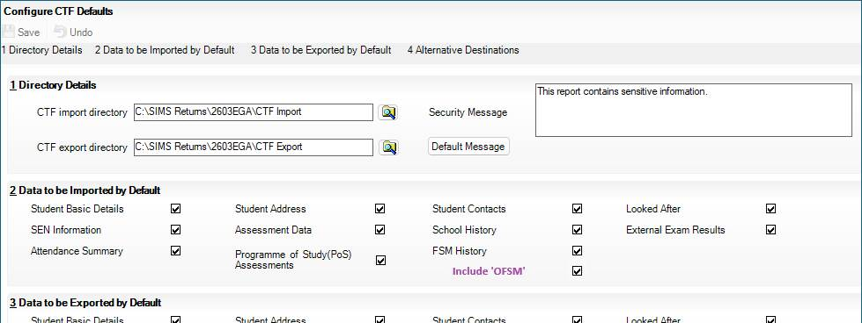
FSM Eligibility changes for Academic Year 2026/27
SIMS 7 Bulk Entry via CTF 26
CTF 26 will also allow the bulk entry of FSM eligibility with a Category of ‘OFSM@ (Other FSM eligibility), but this facility will be defaulted to off in CTF setup as we understand that few schools will want to make use of this facility to start with and would not normally want to import such data from another school.
We understand that in most cases the school would only want to set this facility to on where the CTF file is provided by the local authority or equivalent.
Tools | Setups | CTF
Defaulted to unticked

Slide 22
FSM Eligibility changes for Academic Year 2026/27
A big thank for finding the time to go through this presentation.
I hope you found it helpful.

